Slide 1
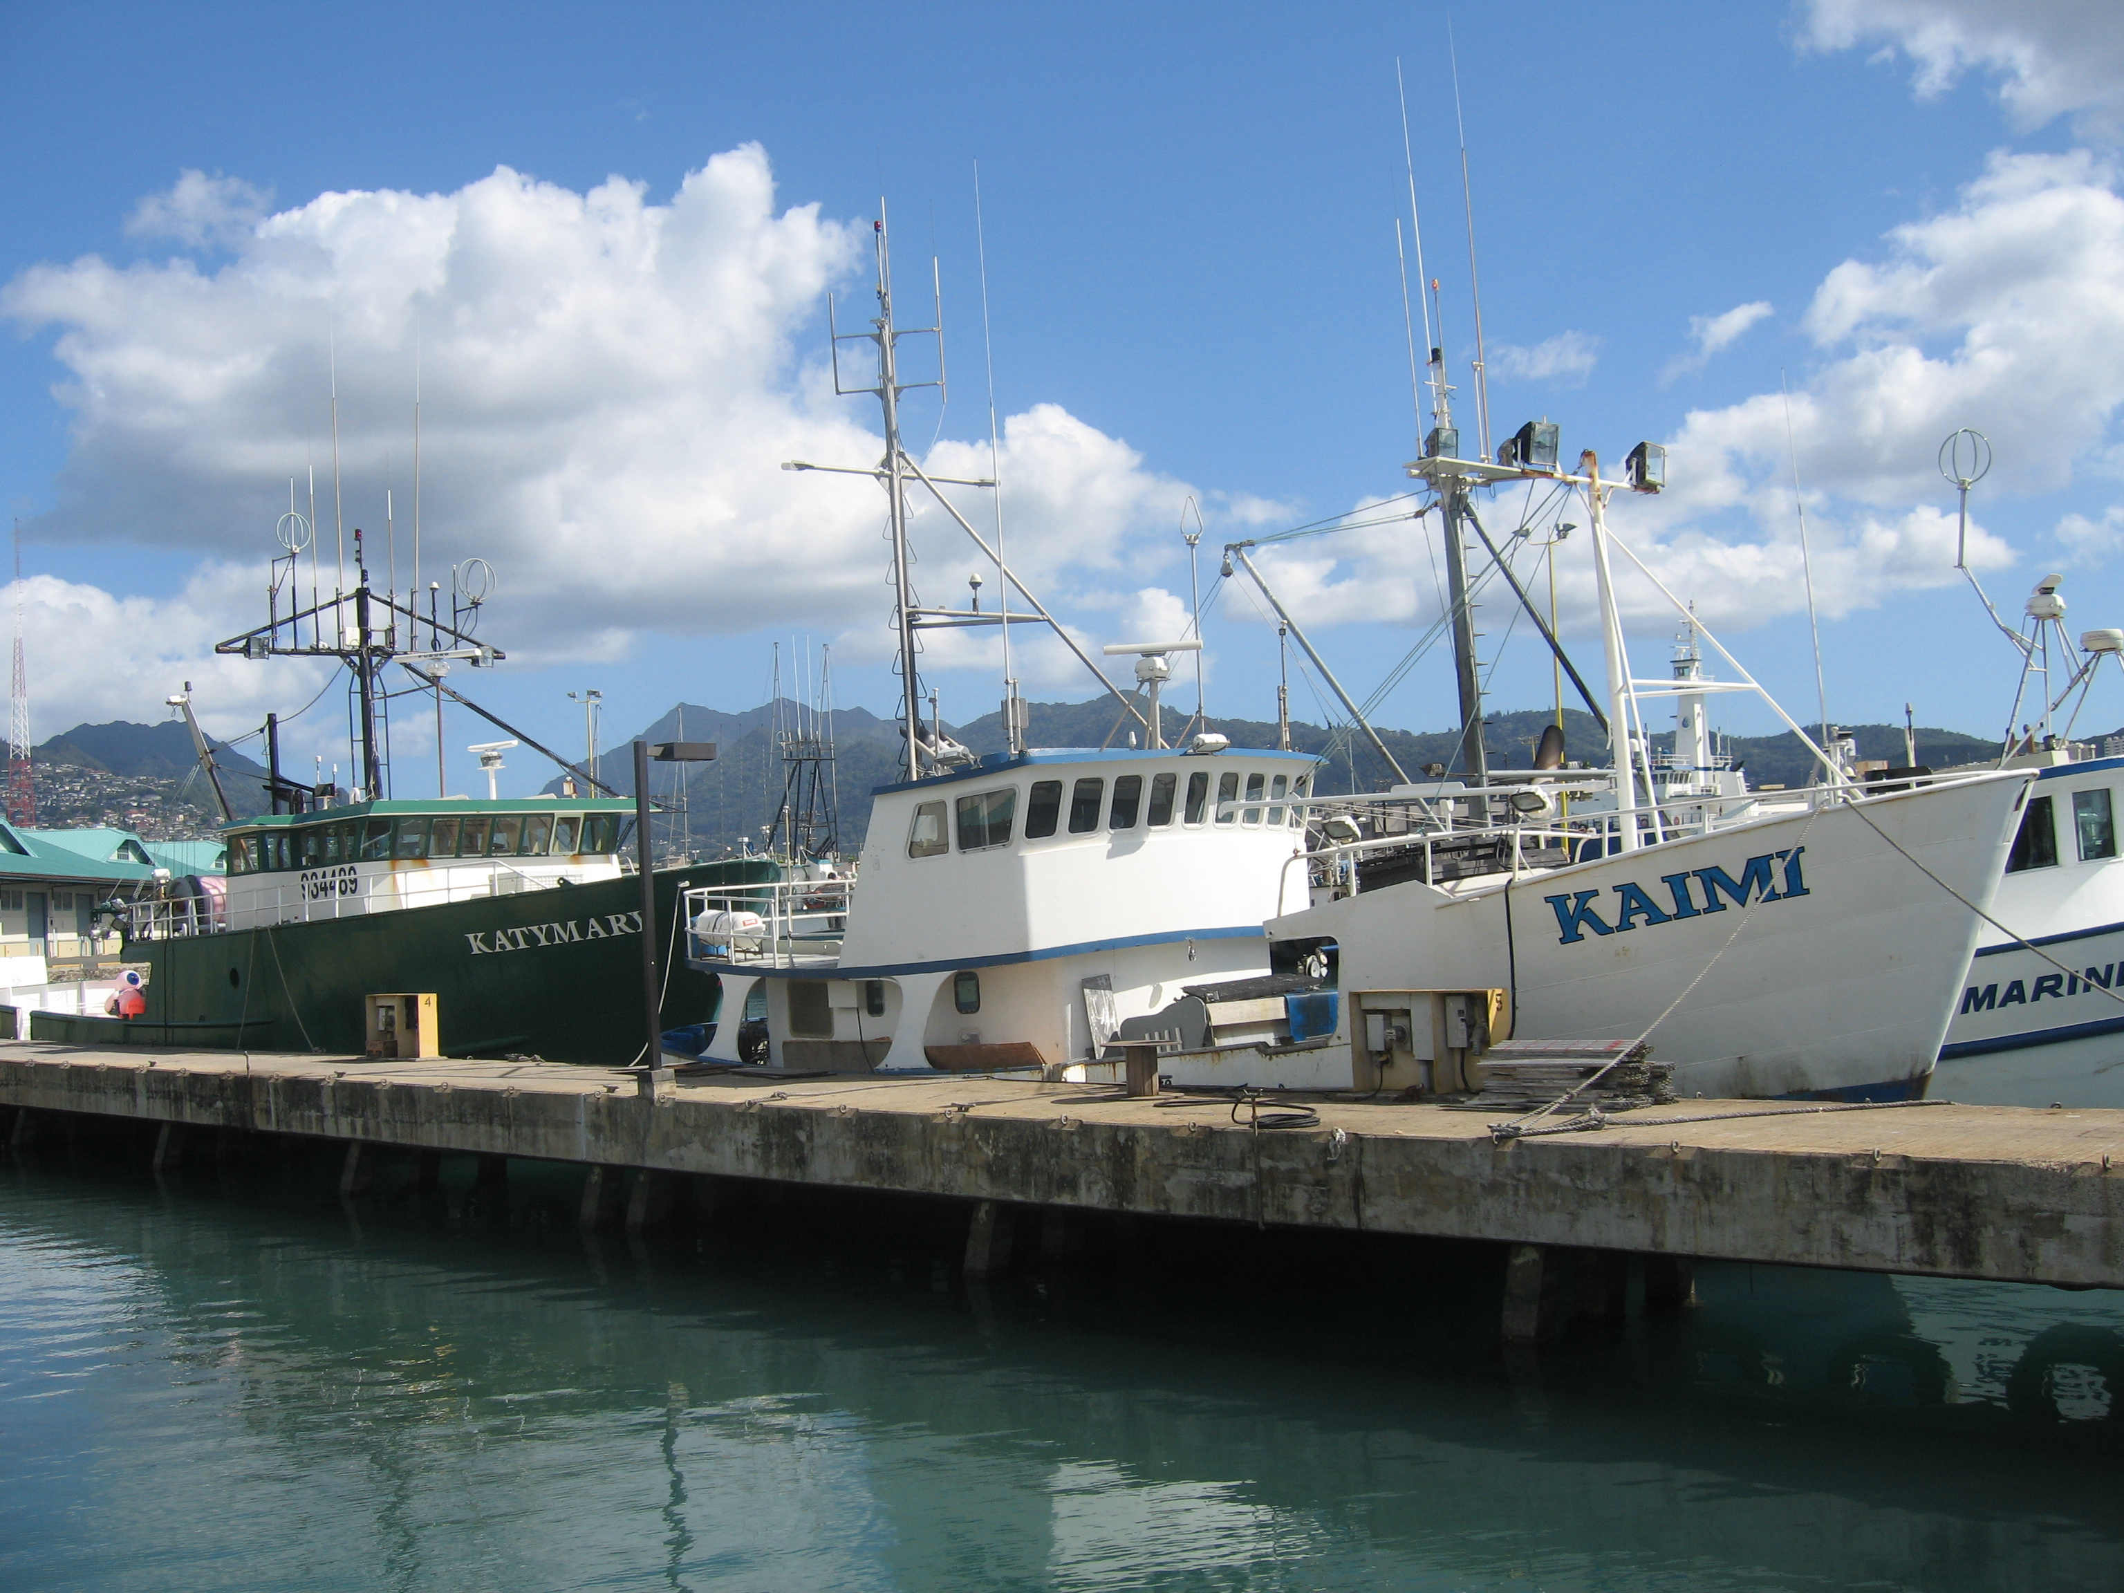

What is a Fishery?
John Kaneko MS, DVM
Hawaii Seafood Council
Photo: John Kaneko

Slide 2
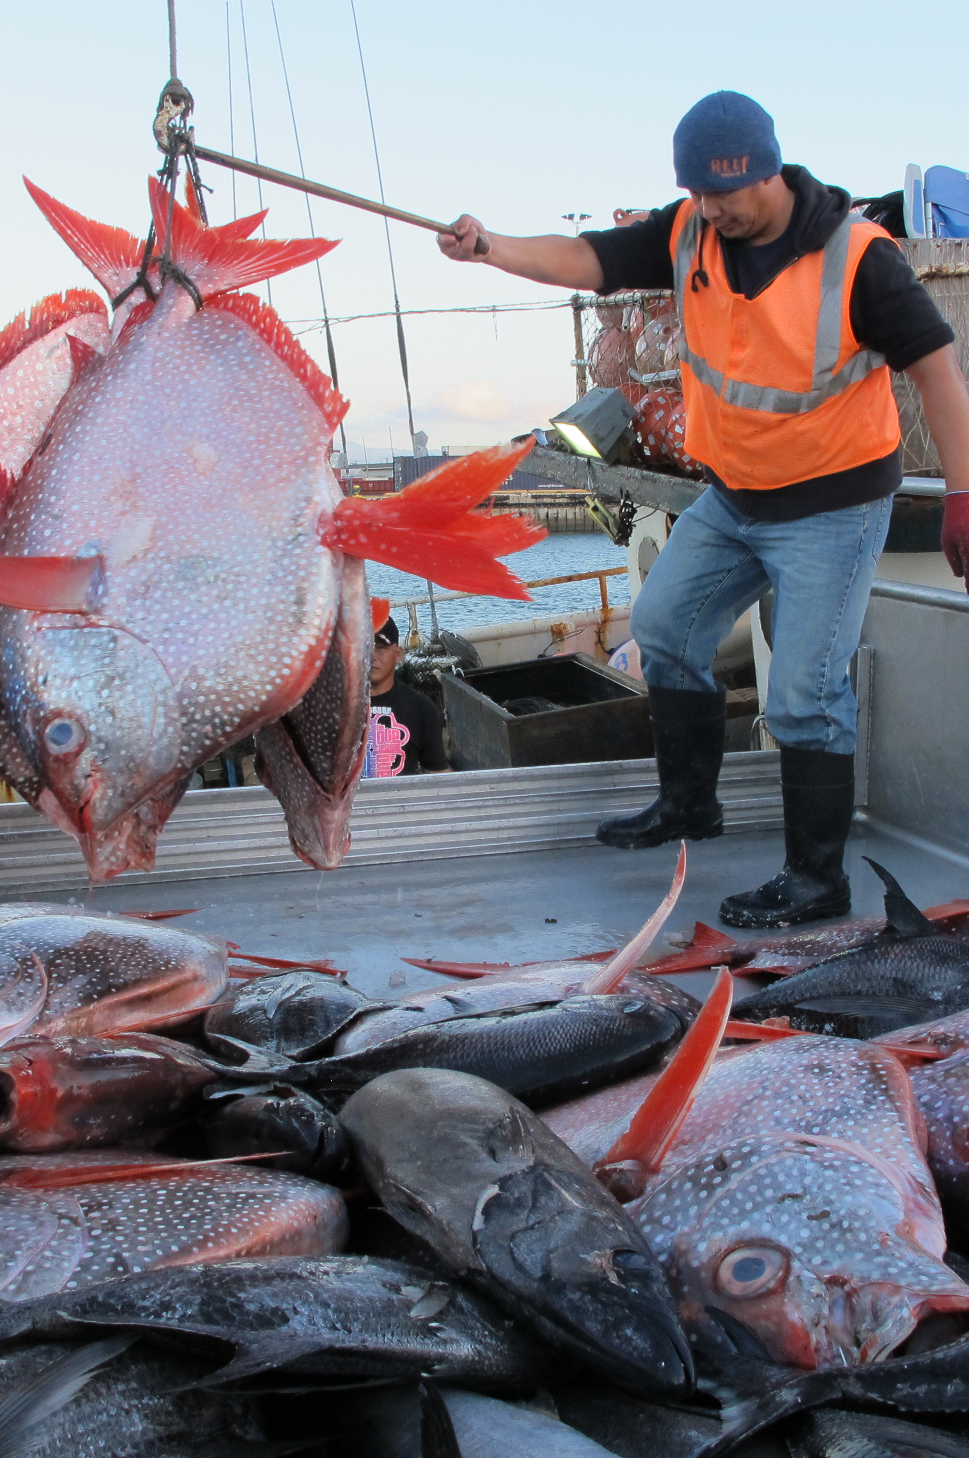
The Simple Definition:
A “Fishery” can be defined simply as the activities involved in catching wild fish or shellfish, or a group of species that share the same habitat.
Photo: John Kaneko

Slide 3
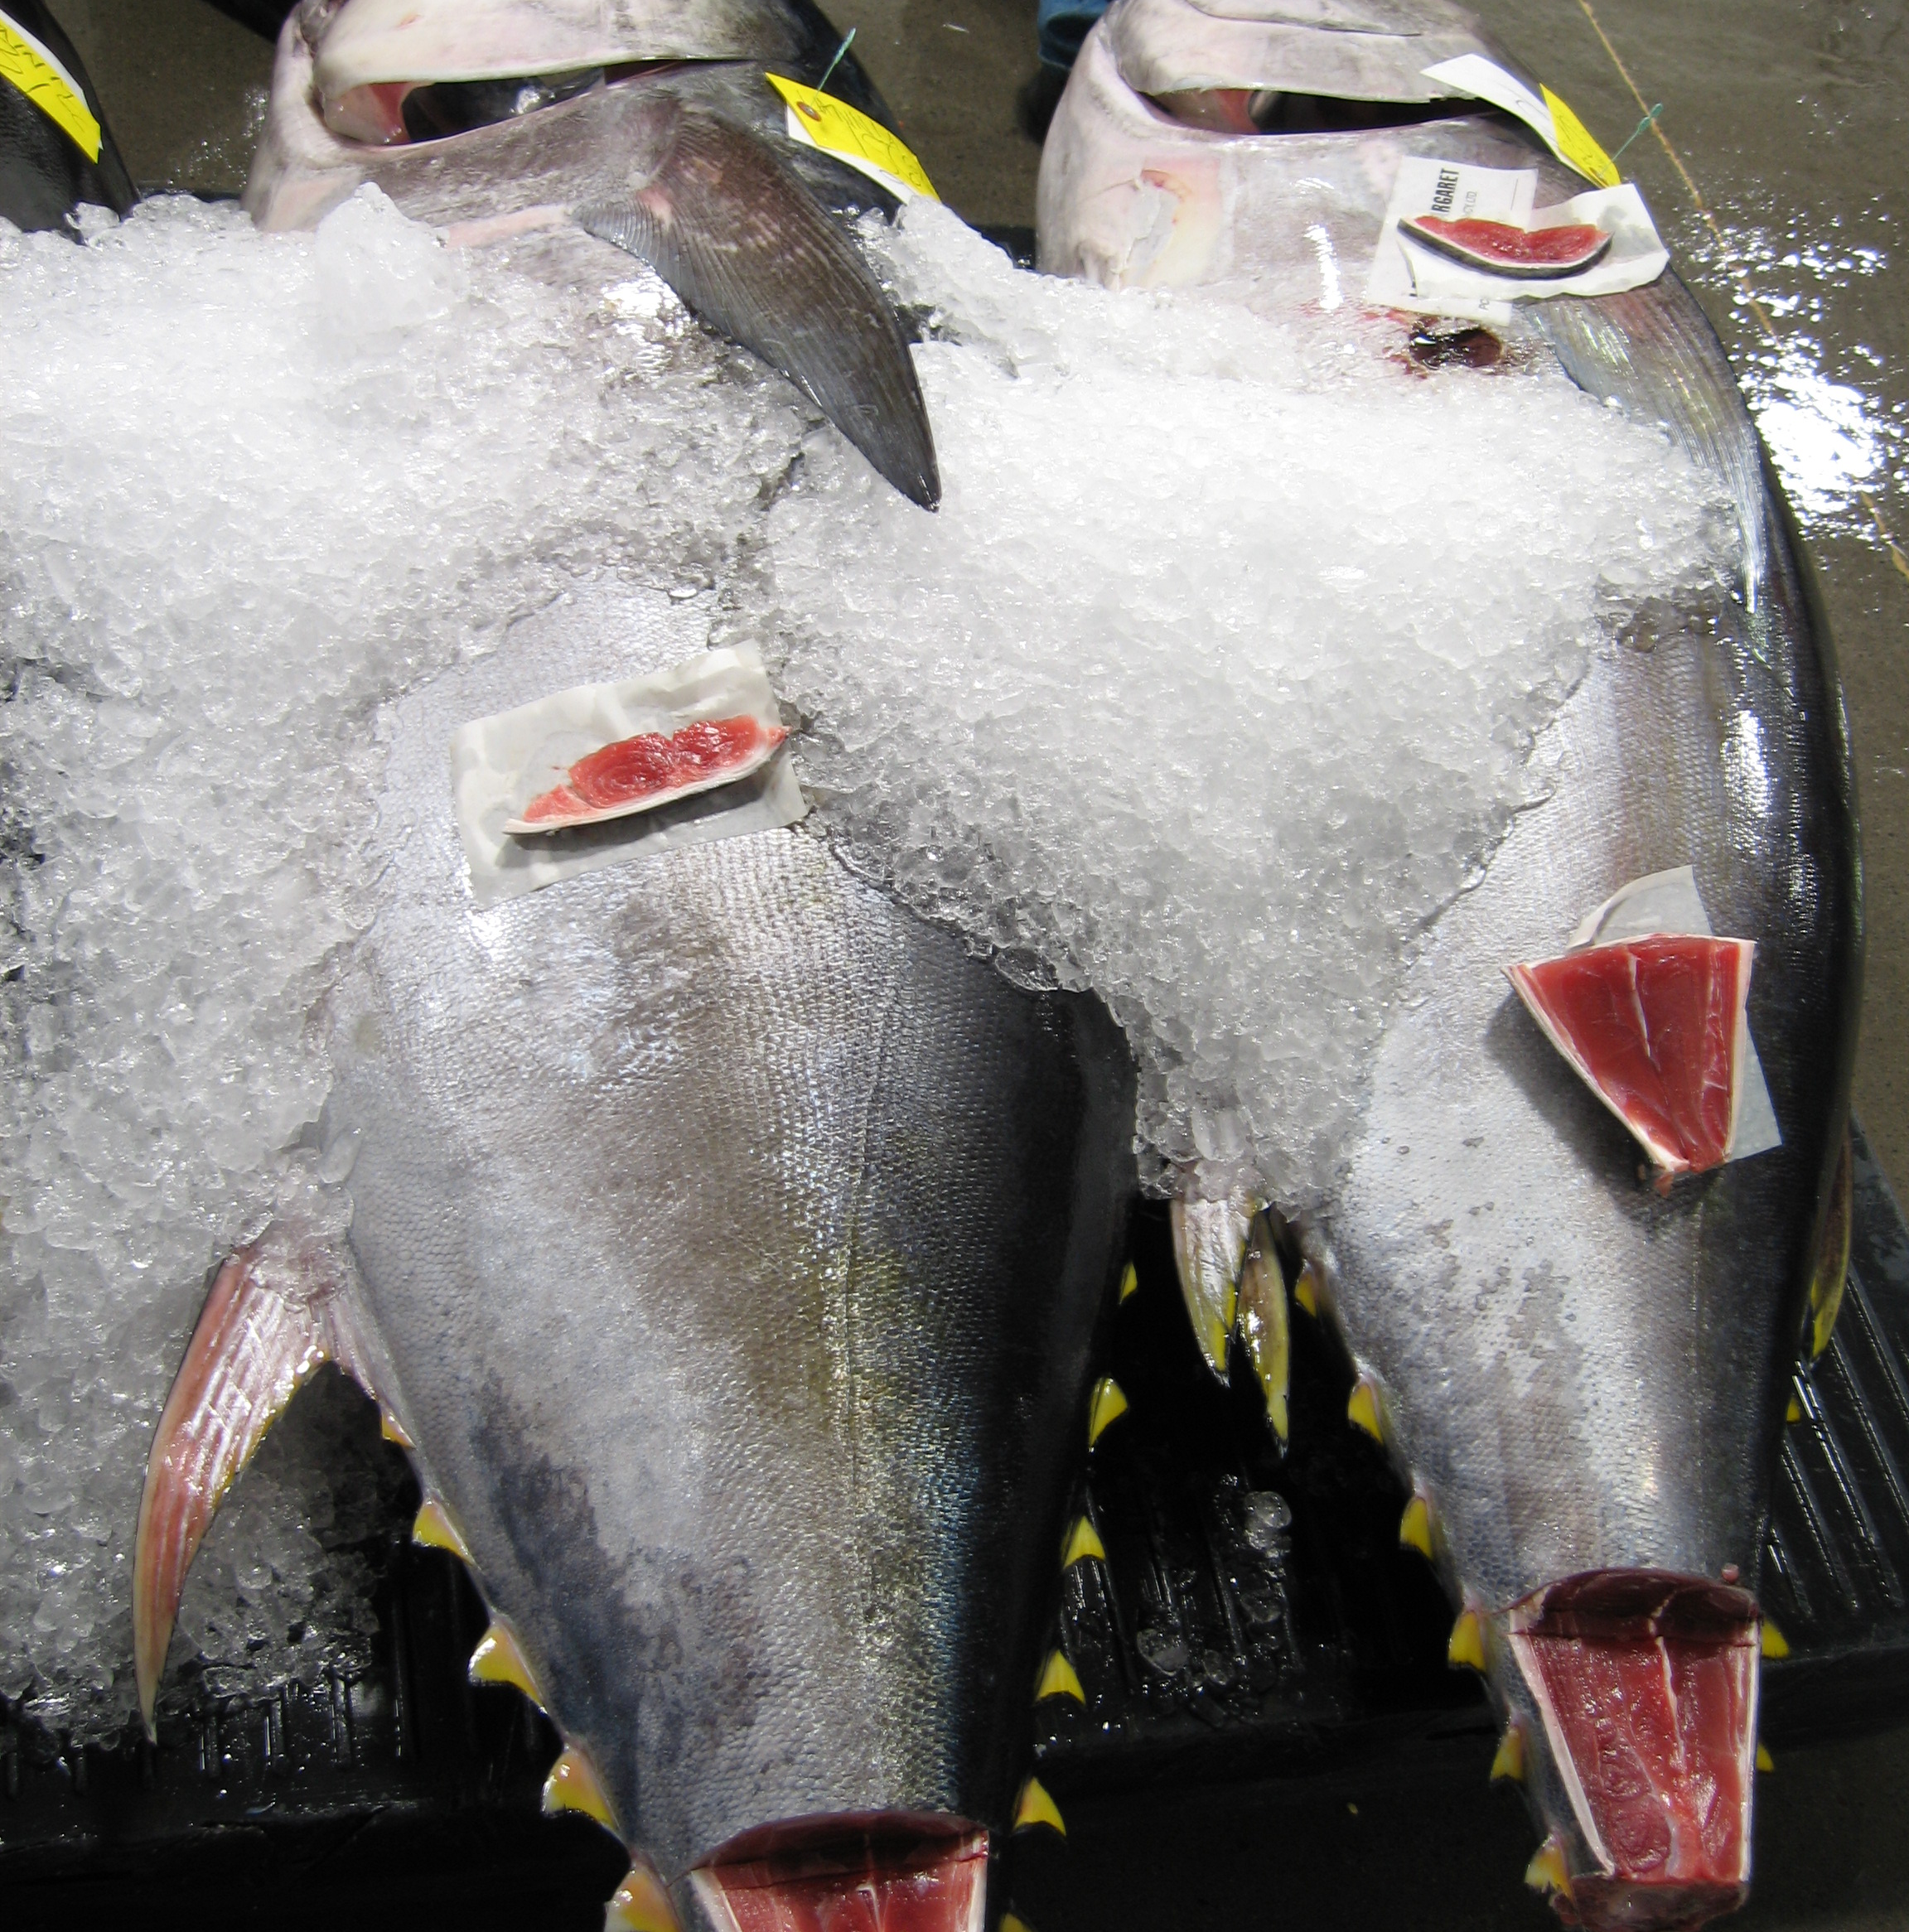
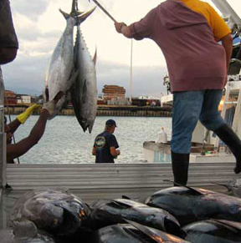
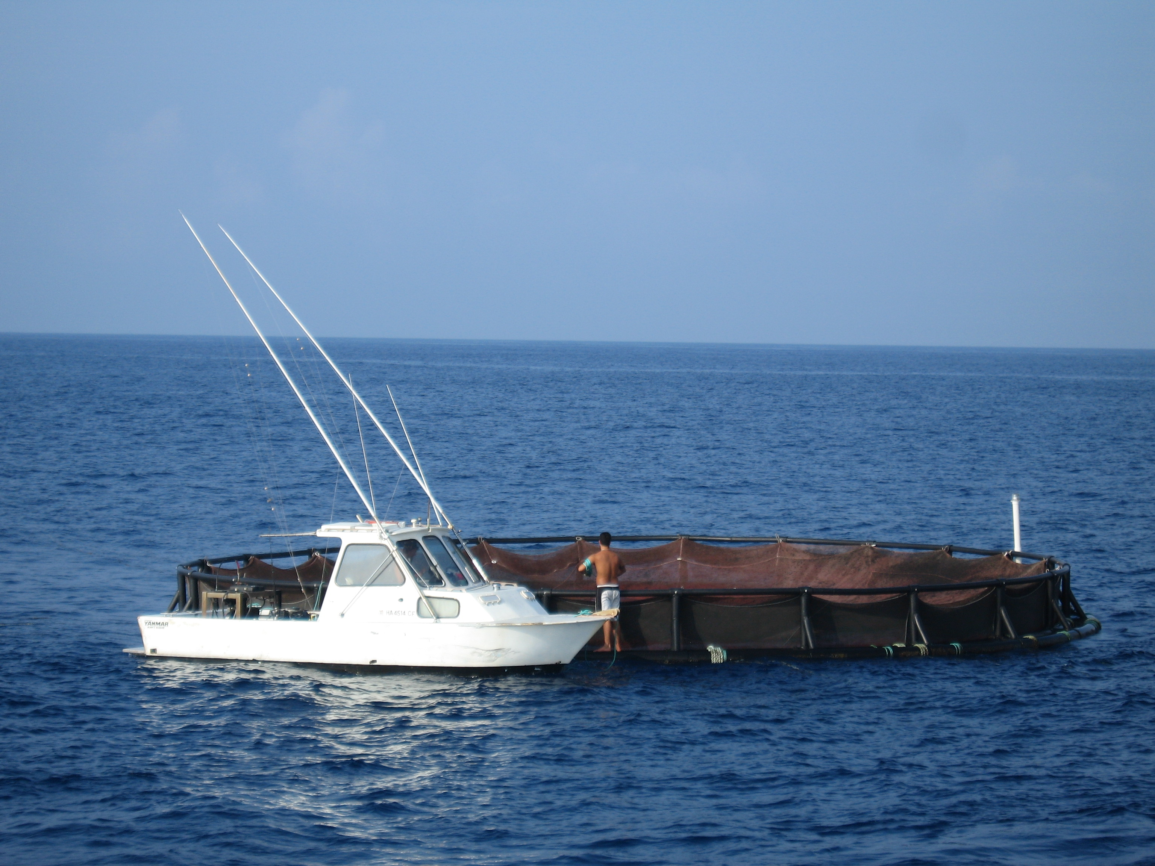
WHAT IS A FISHERY?
The Complex Definition:
Fisheries are complex wild food production systems.
They can be in freshwater, estuarine, and marine environments.
A fish farm (or hatchery) is not a “fishery,” but may be a component of a fishery.
Photos: John Kaneko

Slide 4
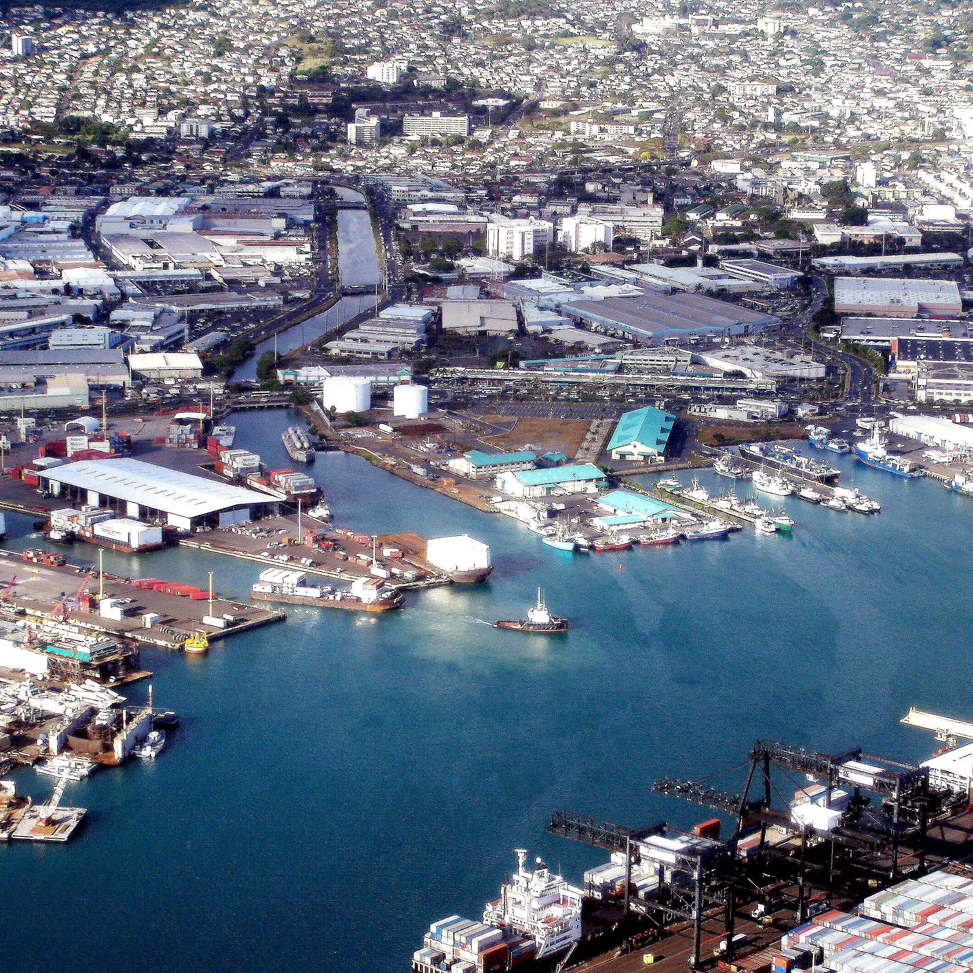
What is a fishery?
Marine Fisheries are further defined by:
Location
Purpose
Environment
Fishing Method
Target Species
Management Jurisdiction
Photo: Bob Lamb Big Island Photography

Slide 5
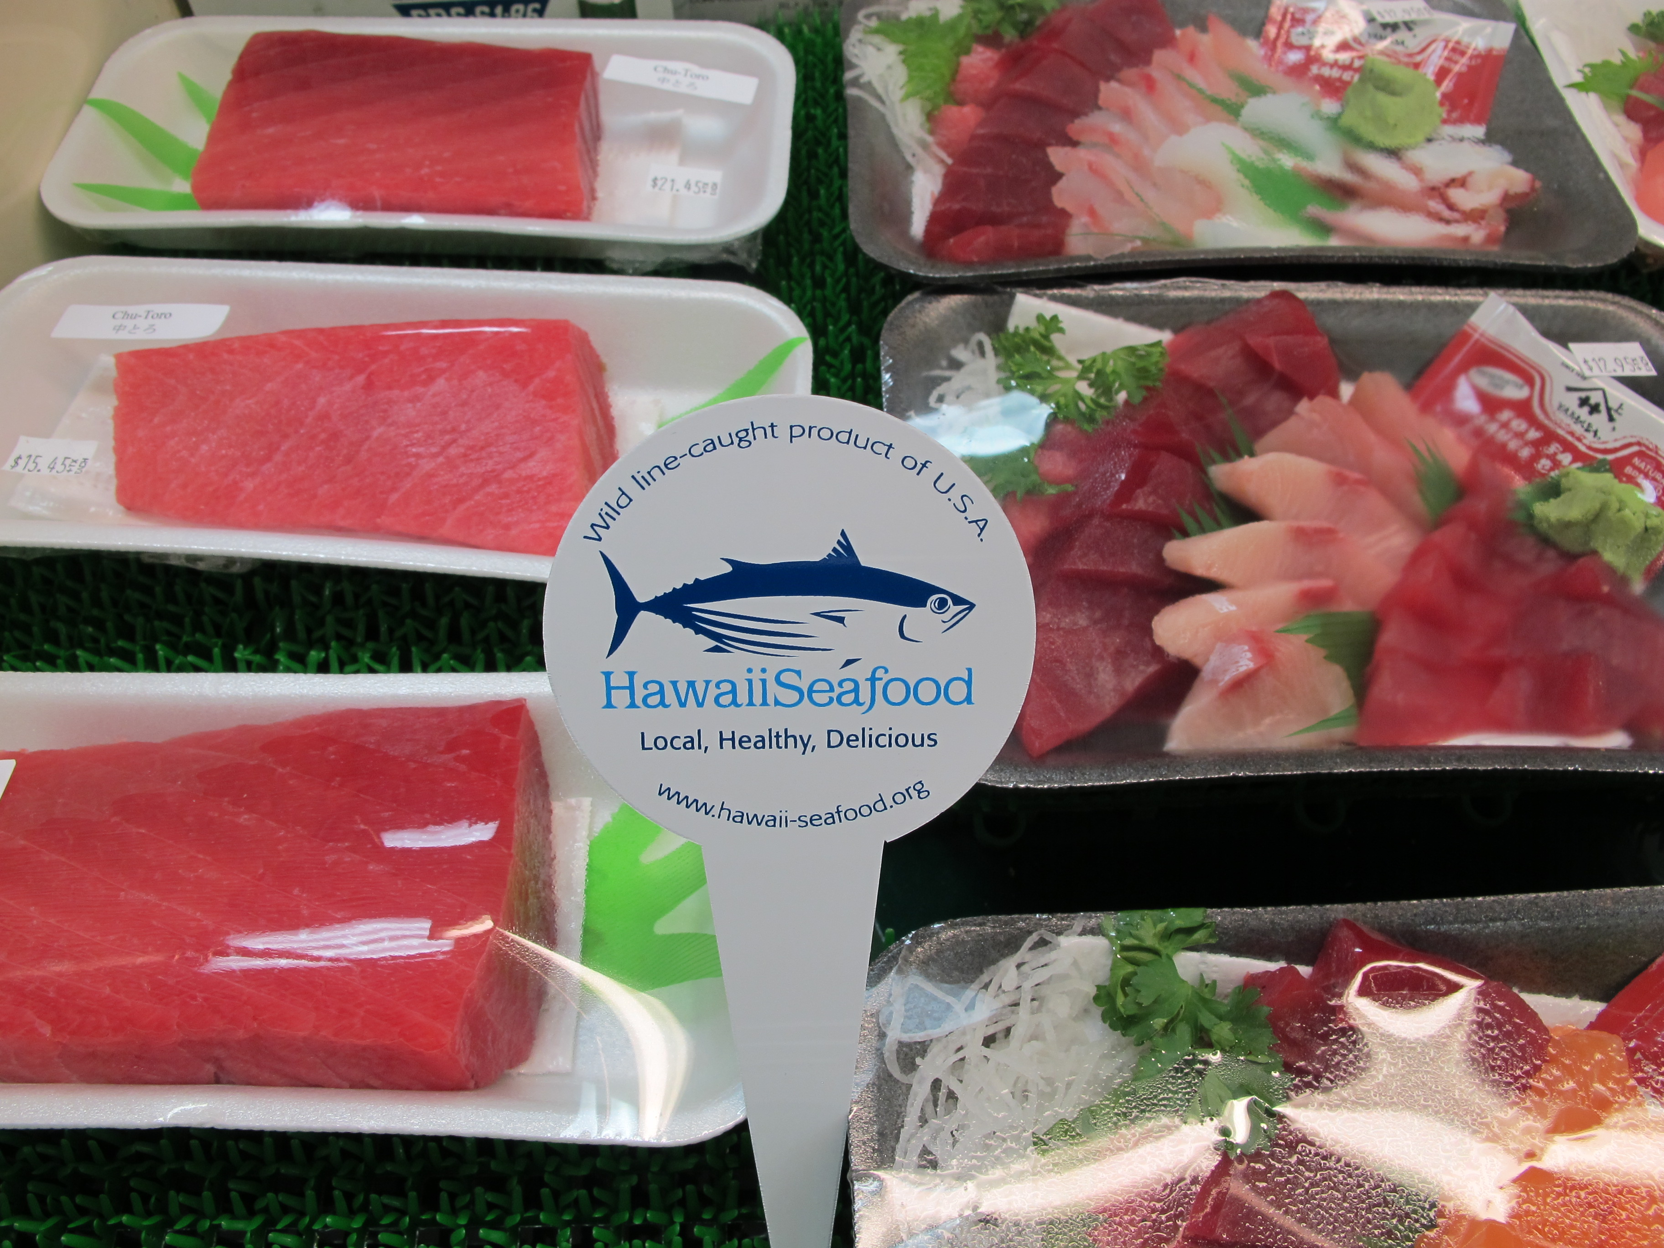
What is a fishery?
Marine Fisheries are further defined by:
Location
Purpose
Environment
Fishing Method
Target Species
Management Jurisdiction
Photo: John Kaneko

Slide 6
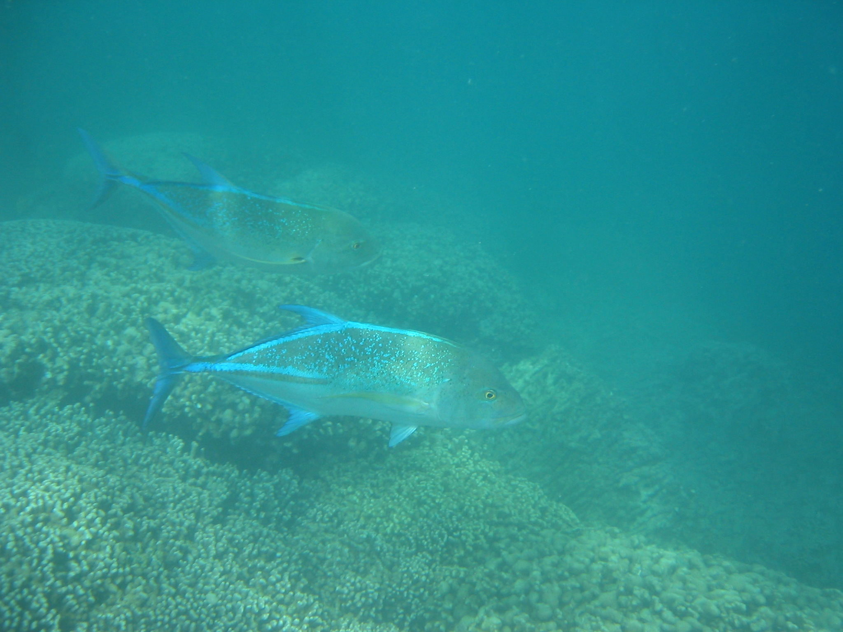
What is a fishery?
Marine Fisheries are further defined by:
Location
Purpose
Environment
Fishing Method
Target Species
Management Jurisdiction
Photo: John Kaneko

Slide 7
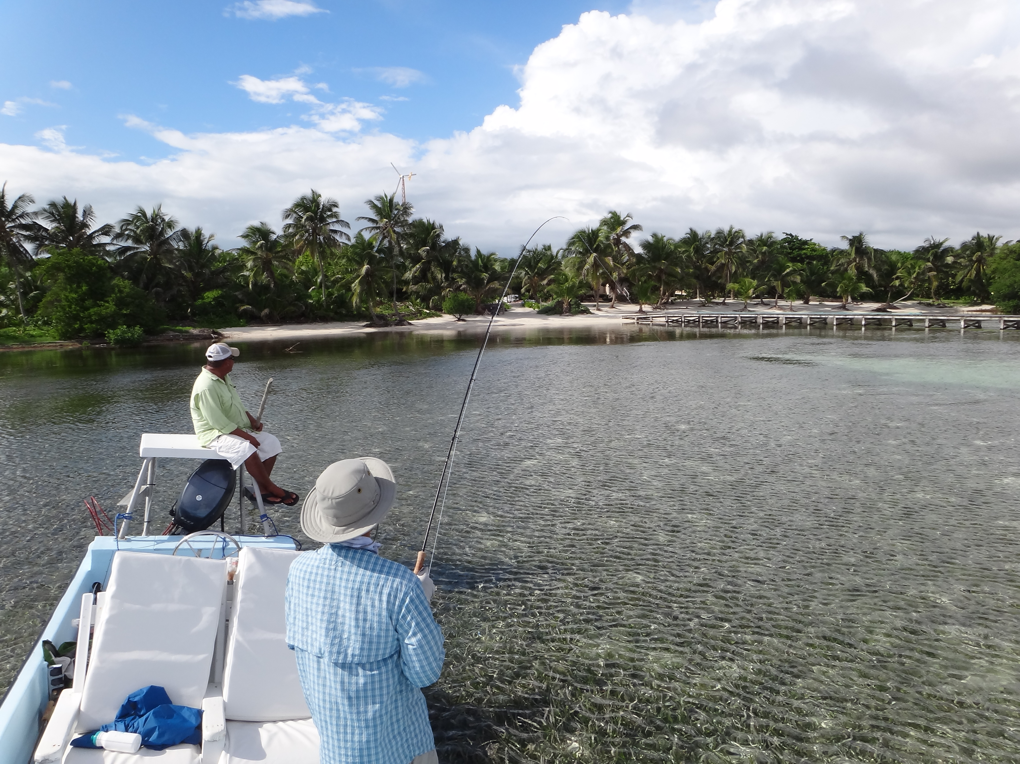
What is a fishery?
Marine Fisheries are further defined by:
Location
Purpose
Environment
Fishing Method
Target Species
Management Jurisdiction
Photo: John Kaneko

Slide 8
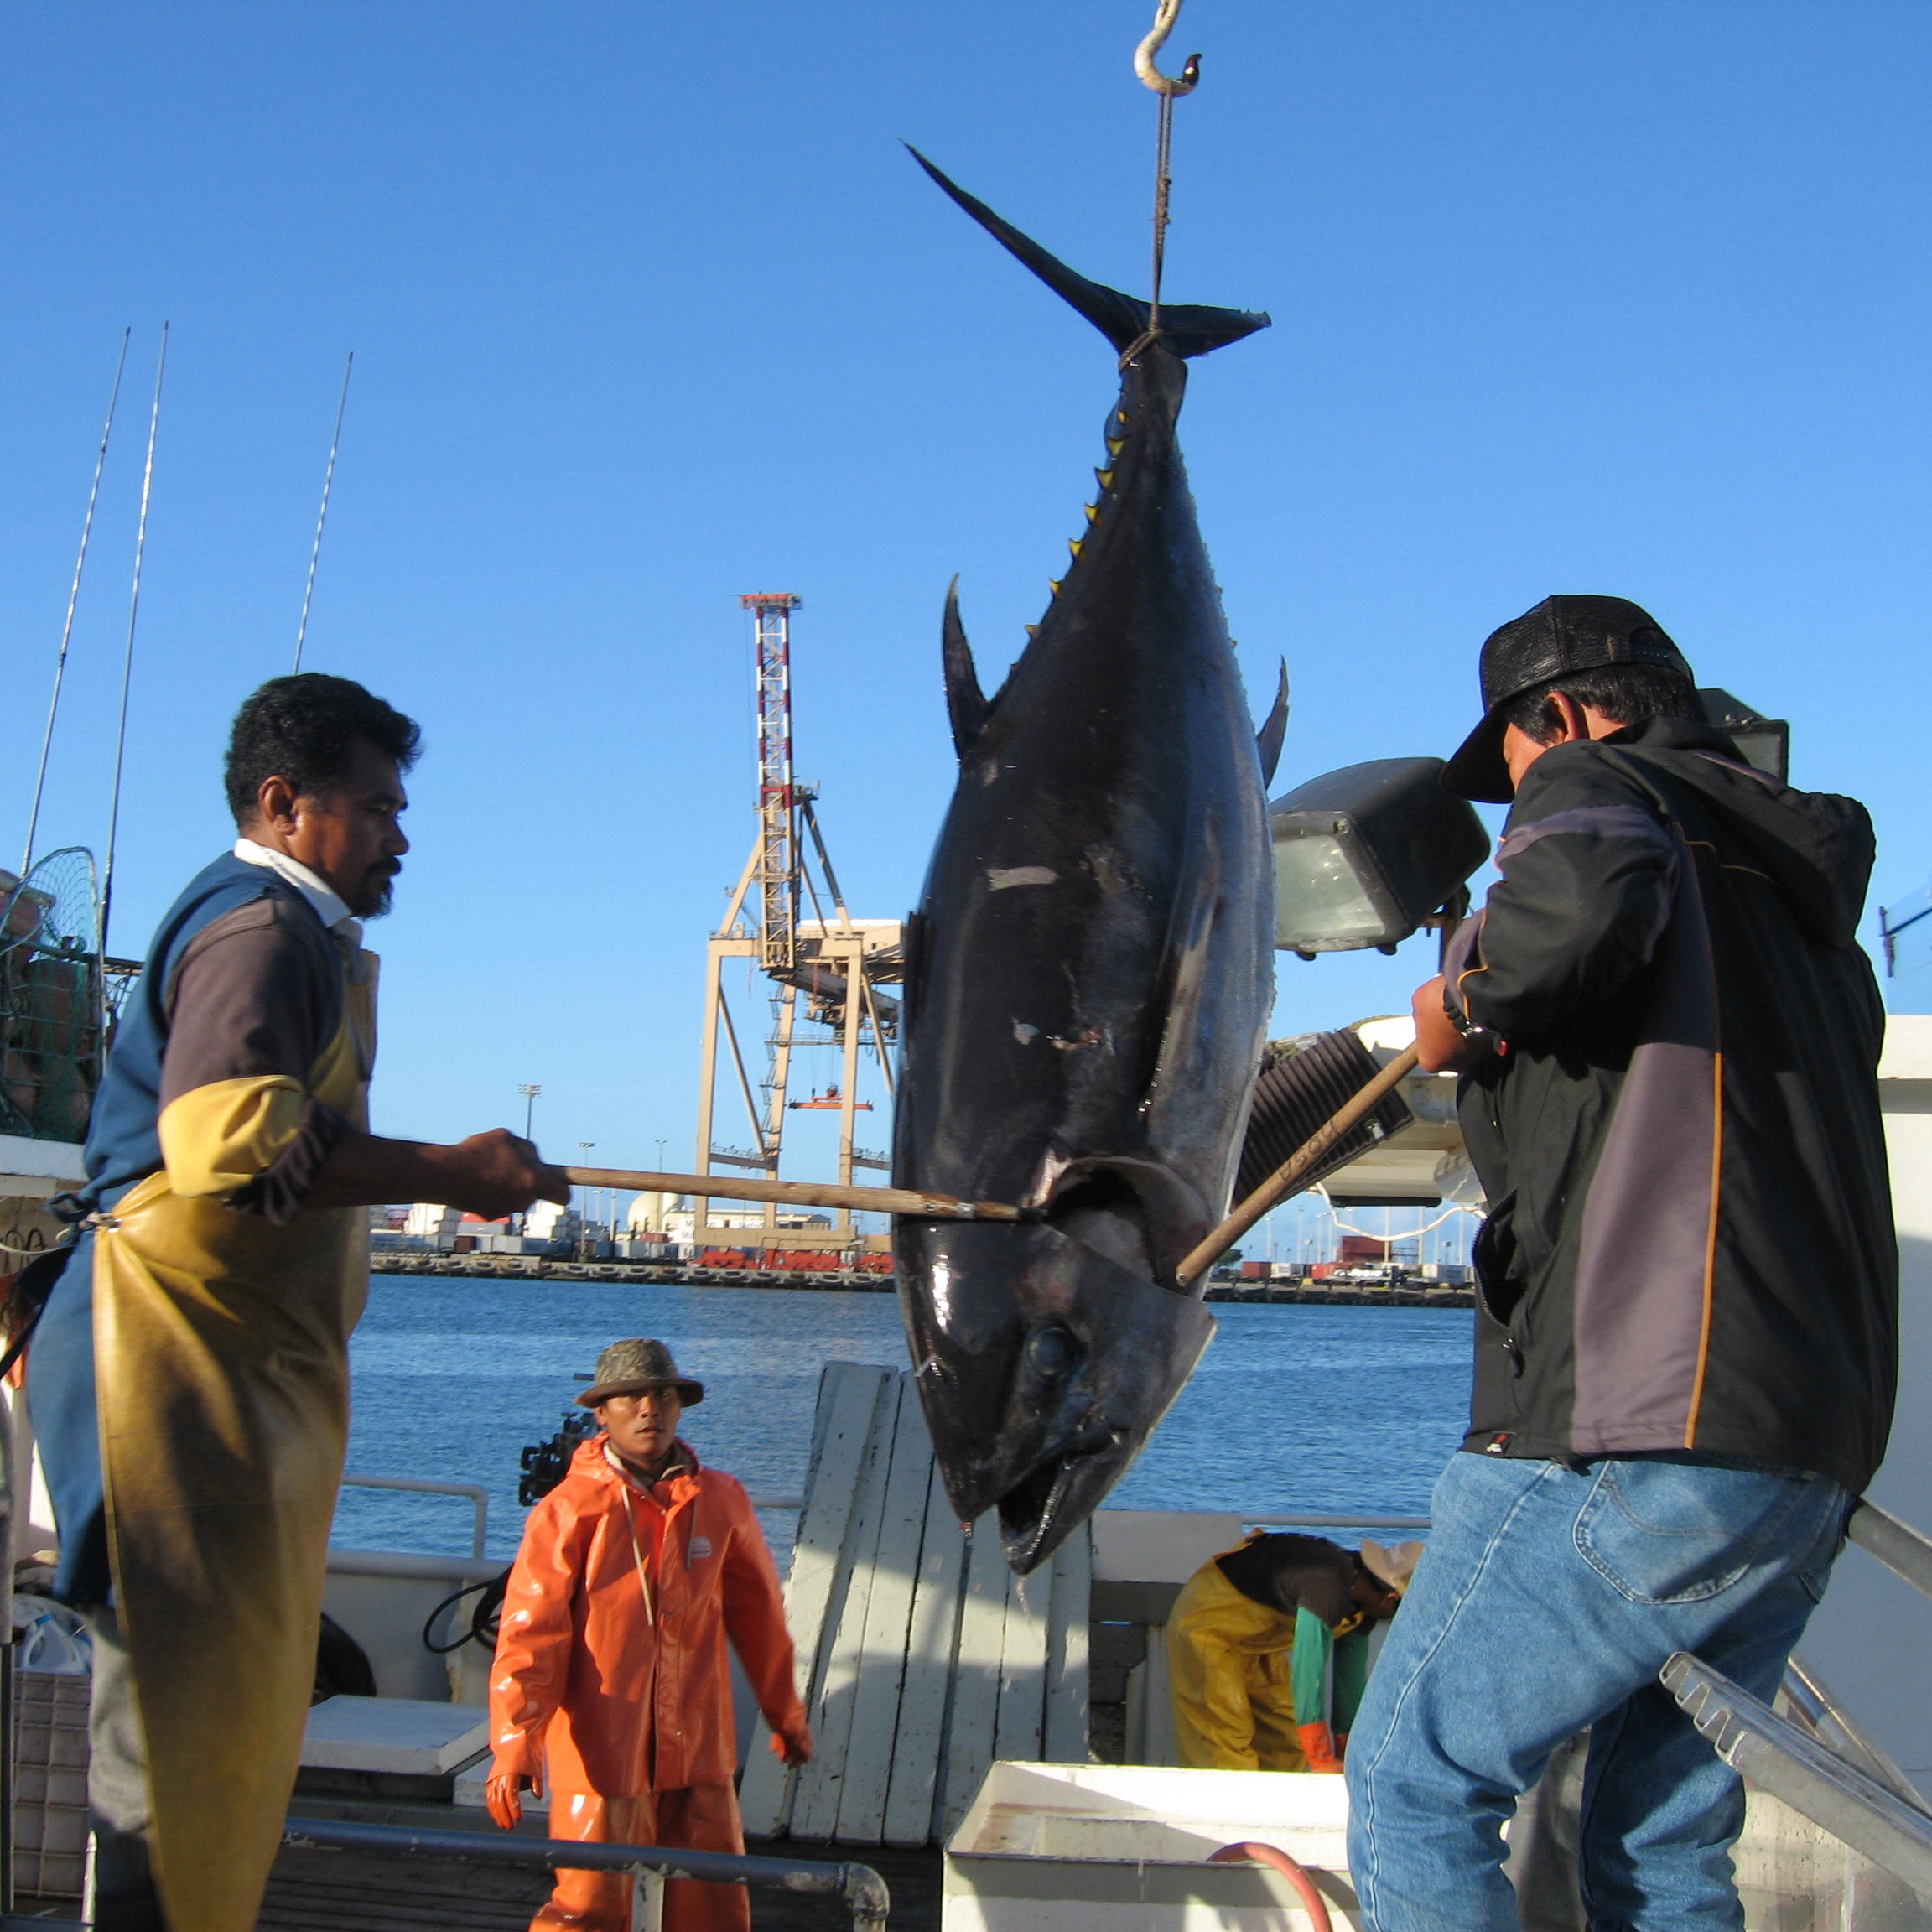
What is a fishery?
Marine Fisheries are further defined by:
Location
Purpose
Environment
Fishing Method
Target Species
Management Jurisdiction
Photo: John Kaneko

Slide 9
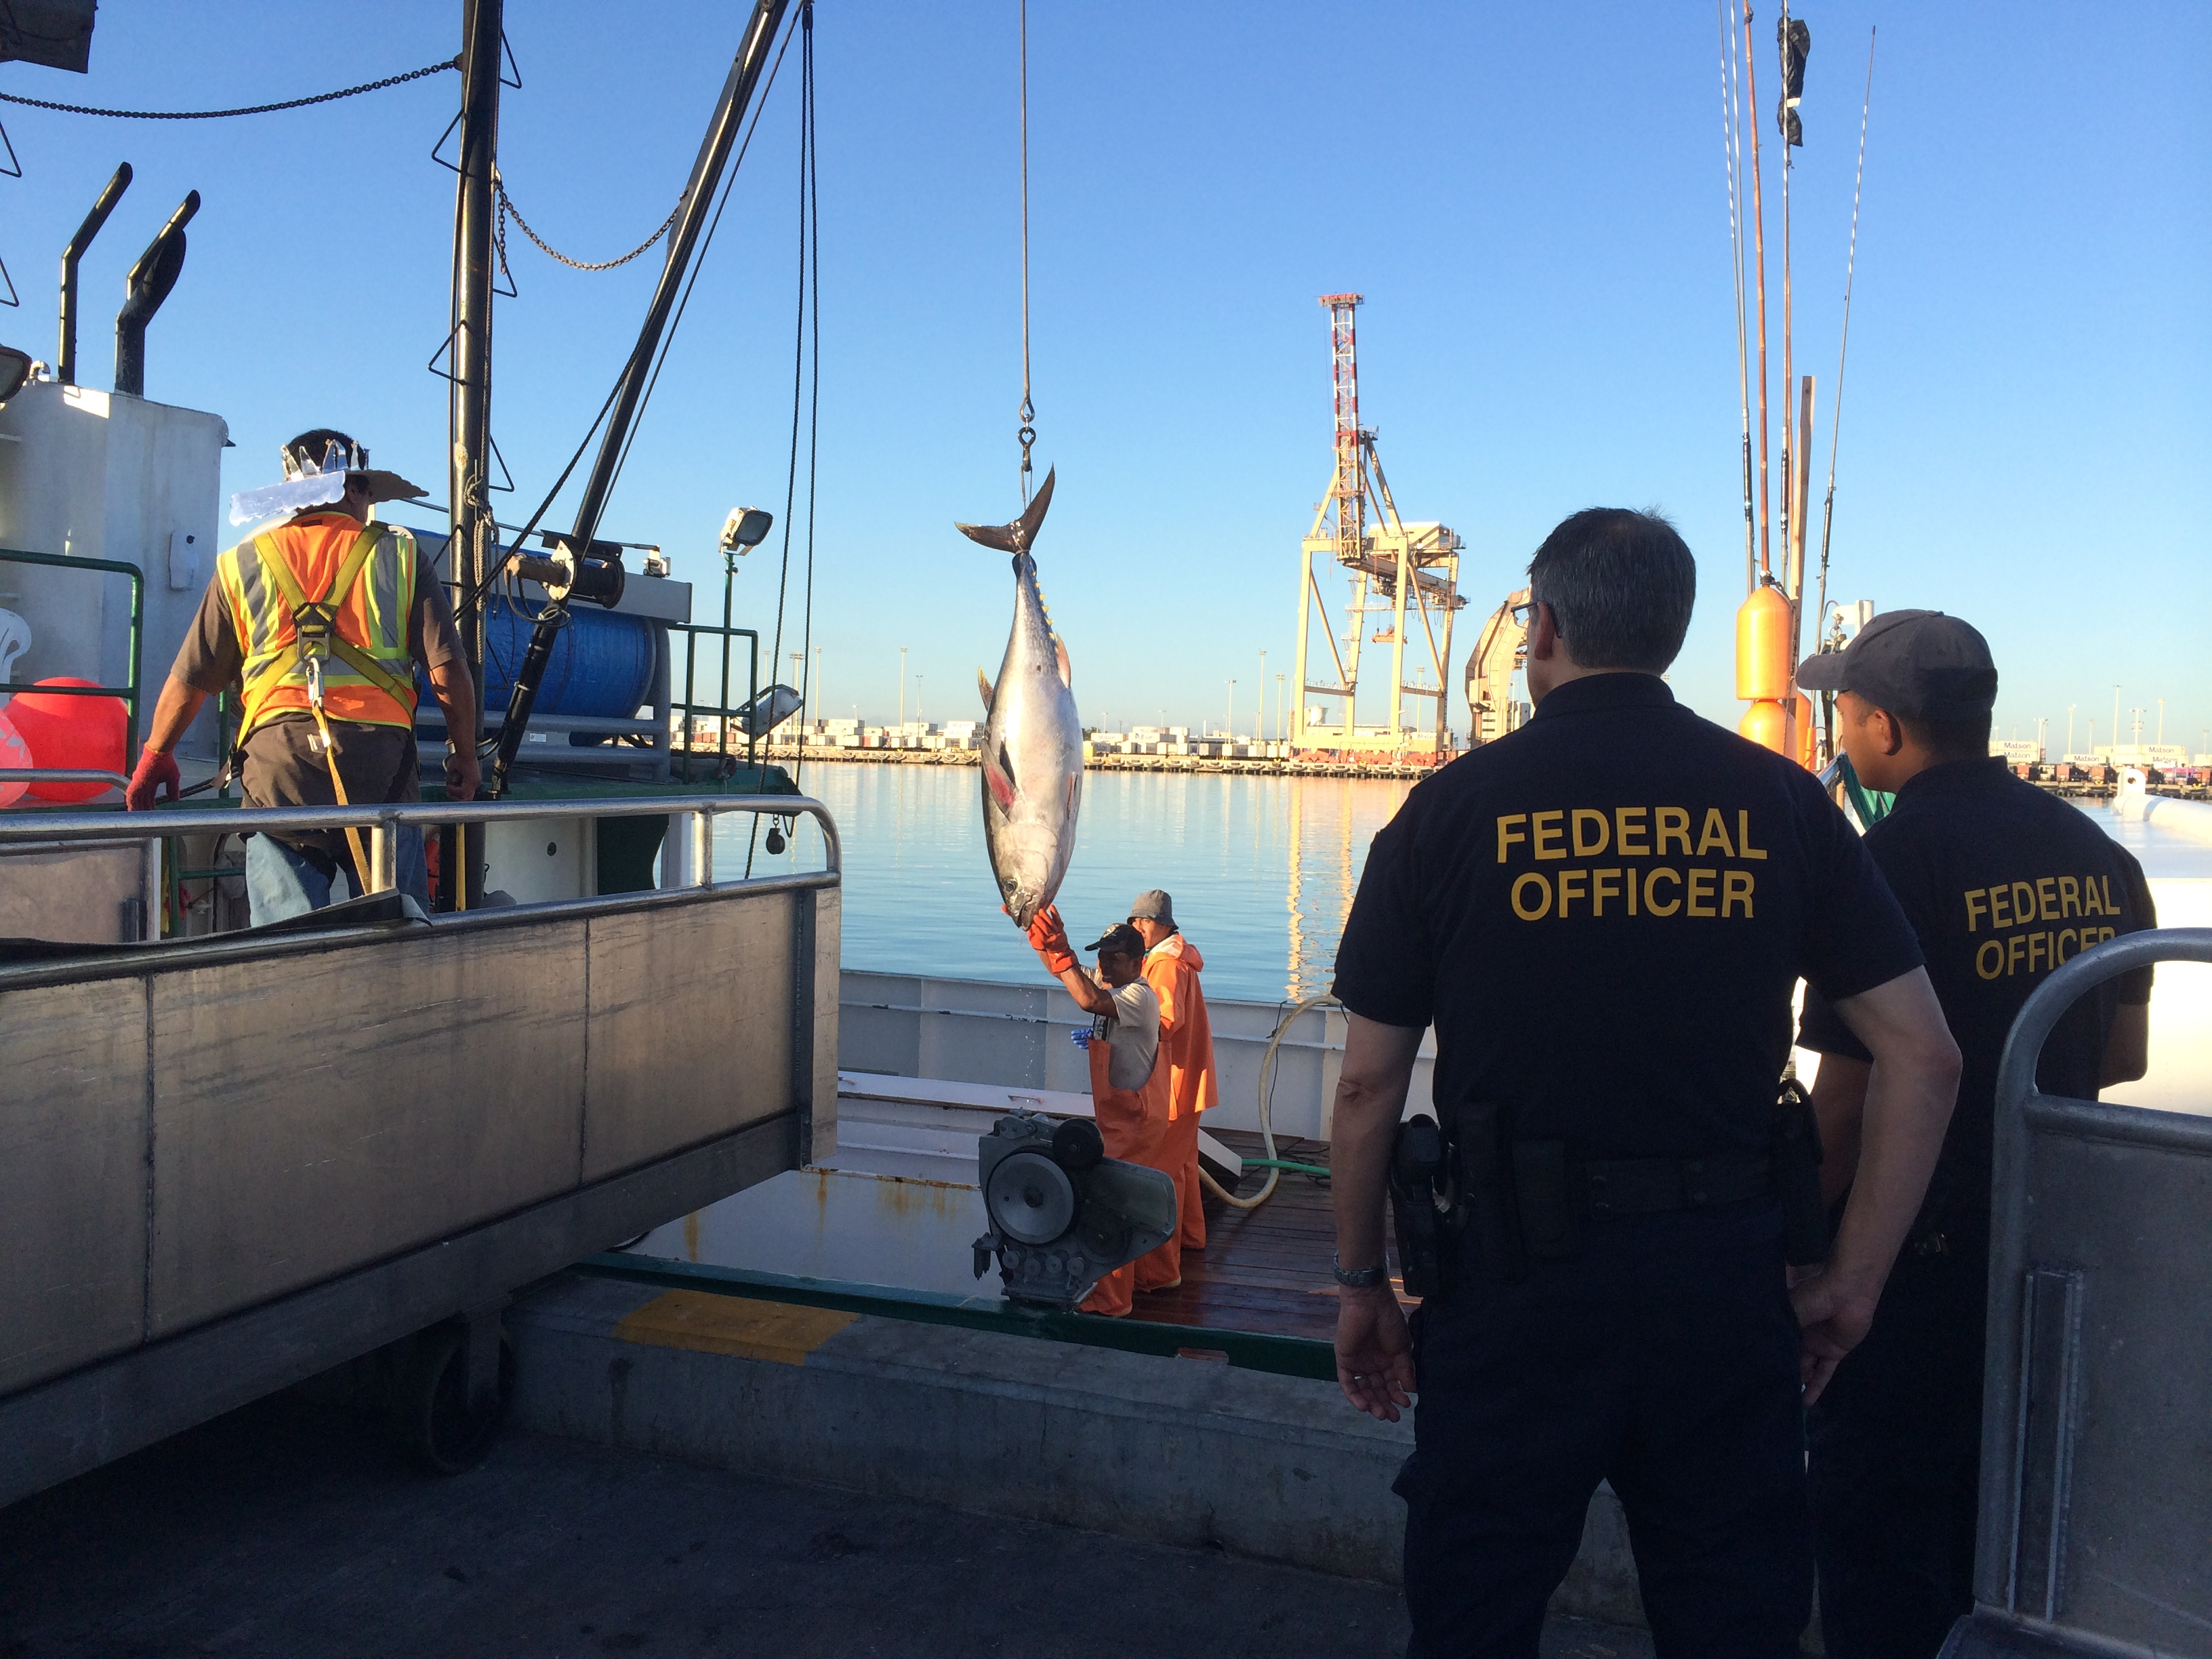
What is a fishery?
Marine Fisheries are further defined by:
Location
Purpose
Environment
Fishing Method
Target Species
Management Jurisdiction
Photo: John Kaneko

Slide 10
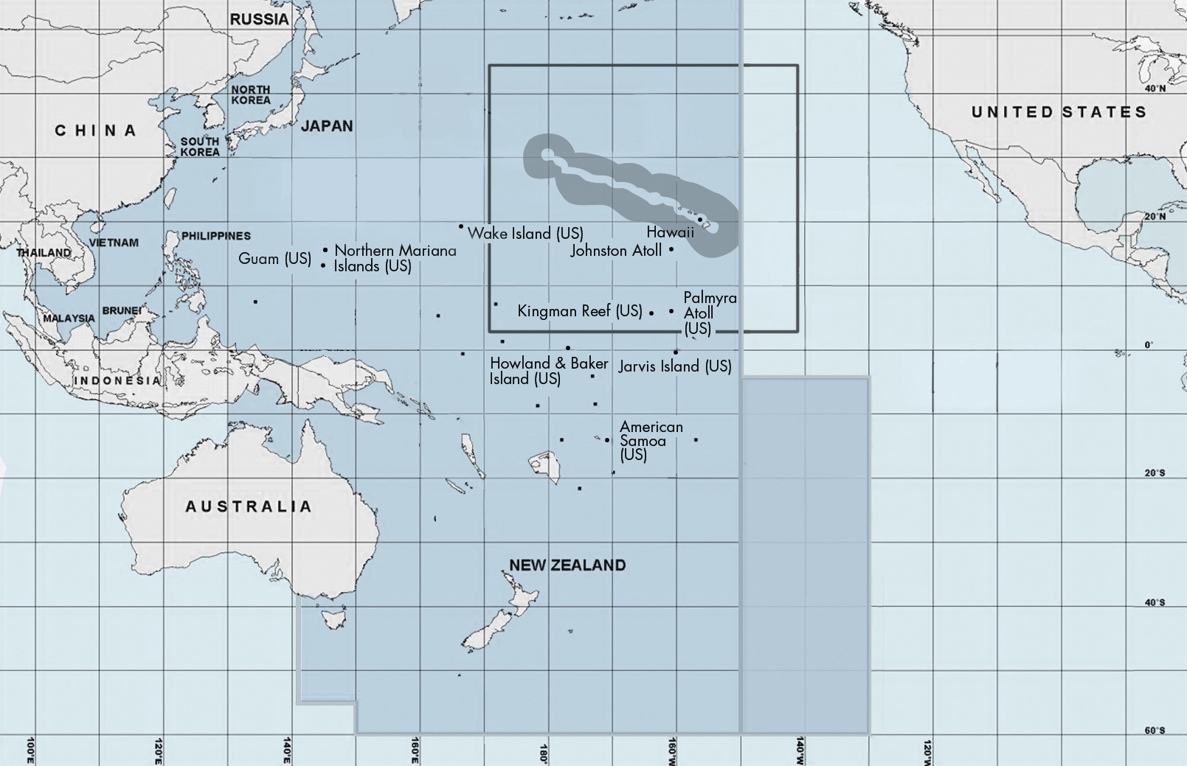
Defining by Location
Location is important and needs to be defined, especially in context of
fishery management jurisdiction and
fishing regulations.

Slide 11
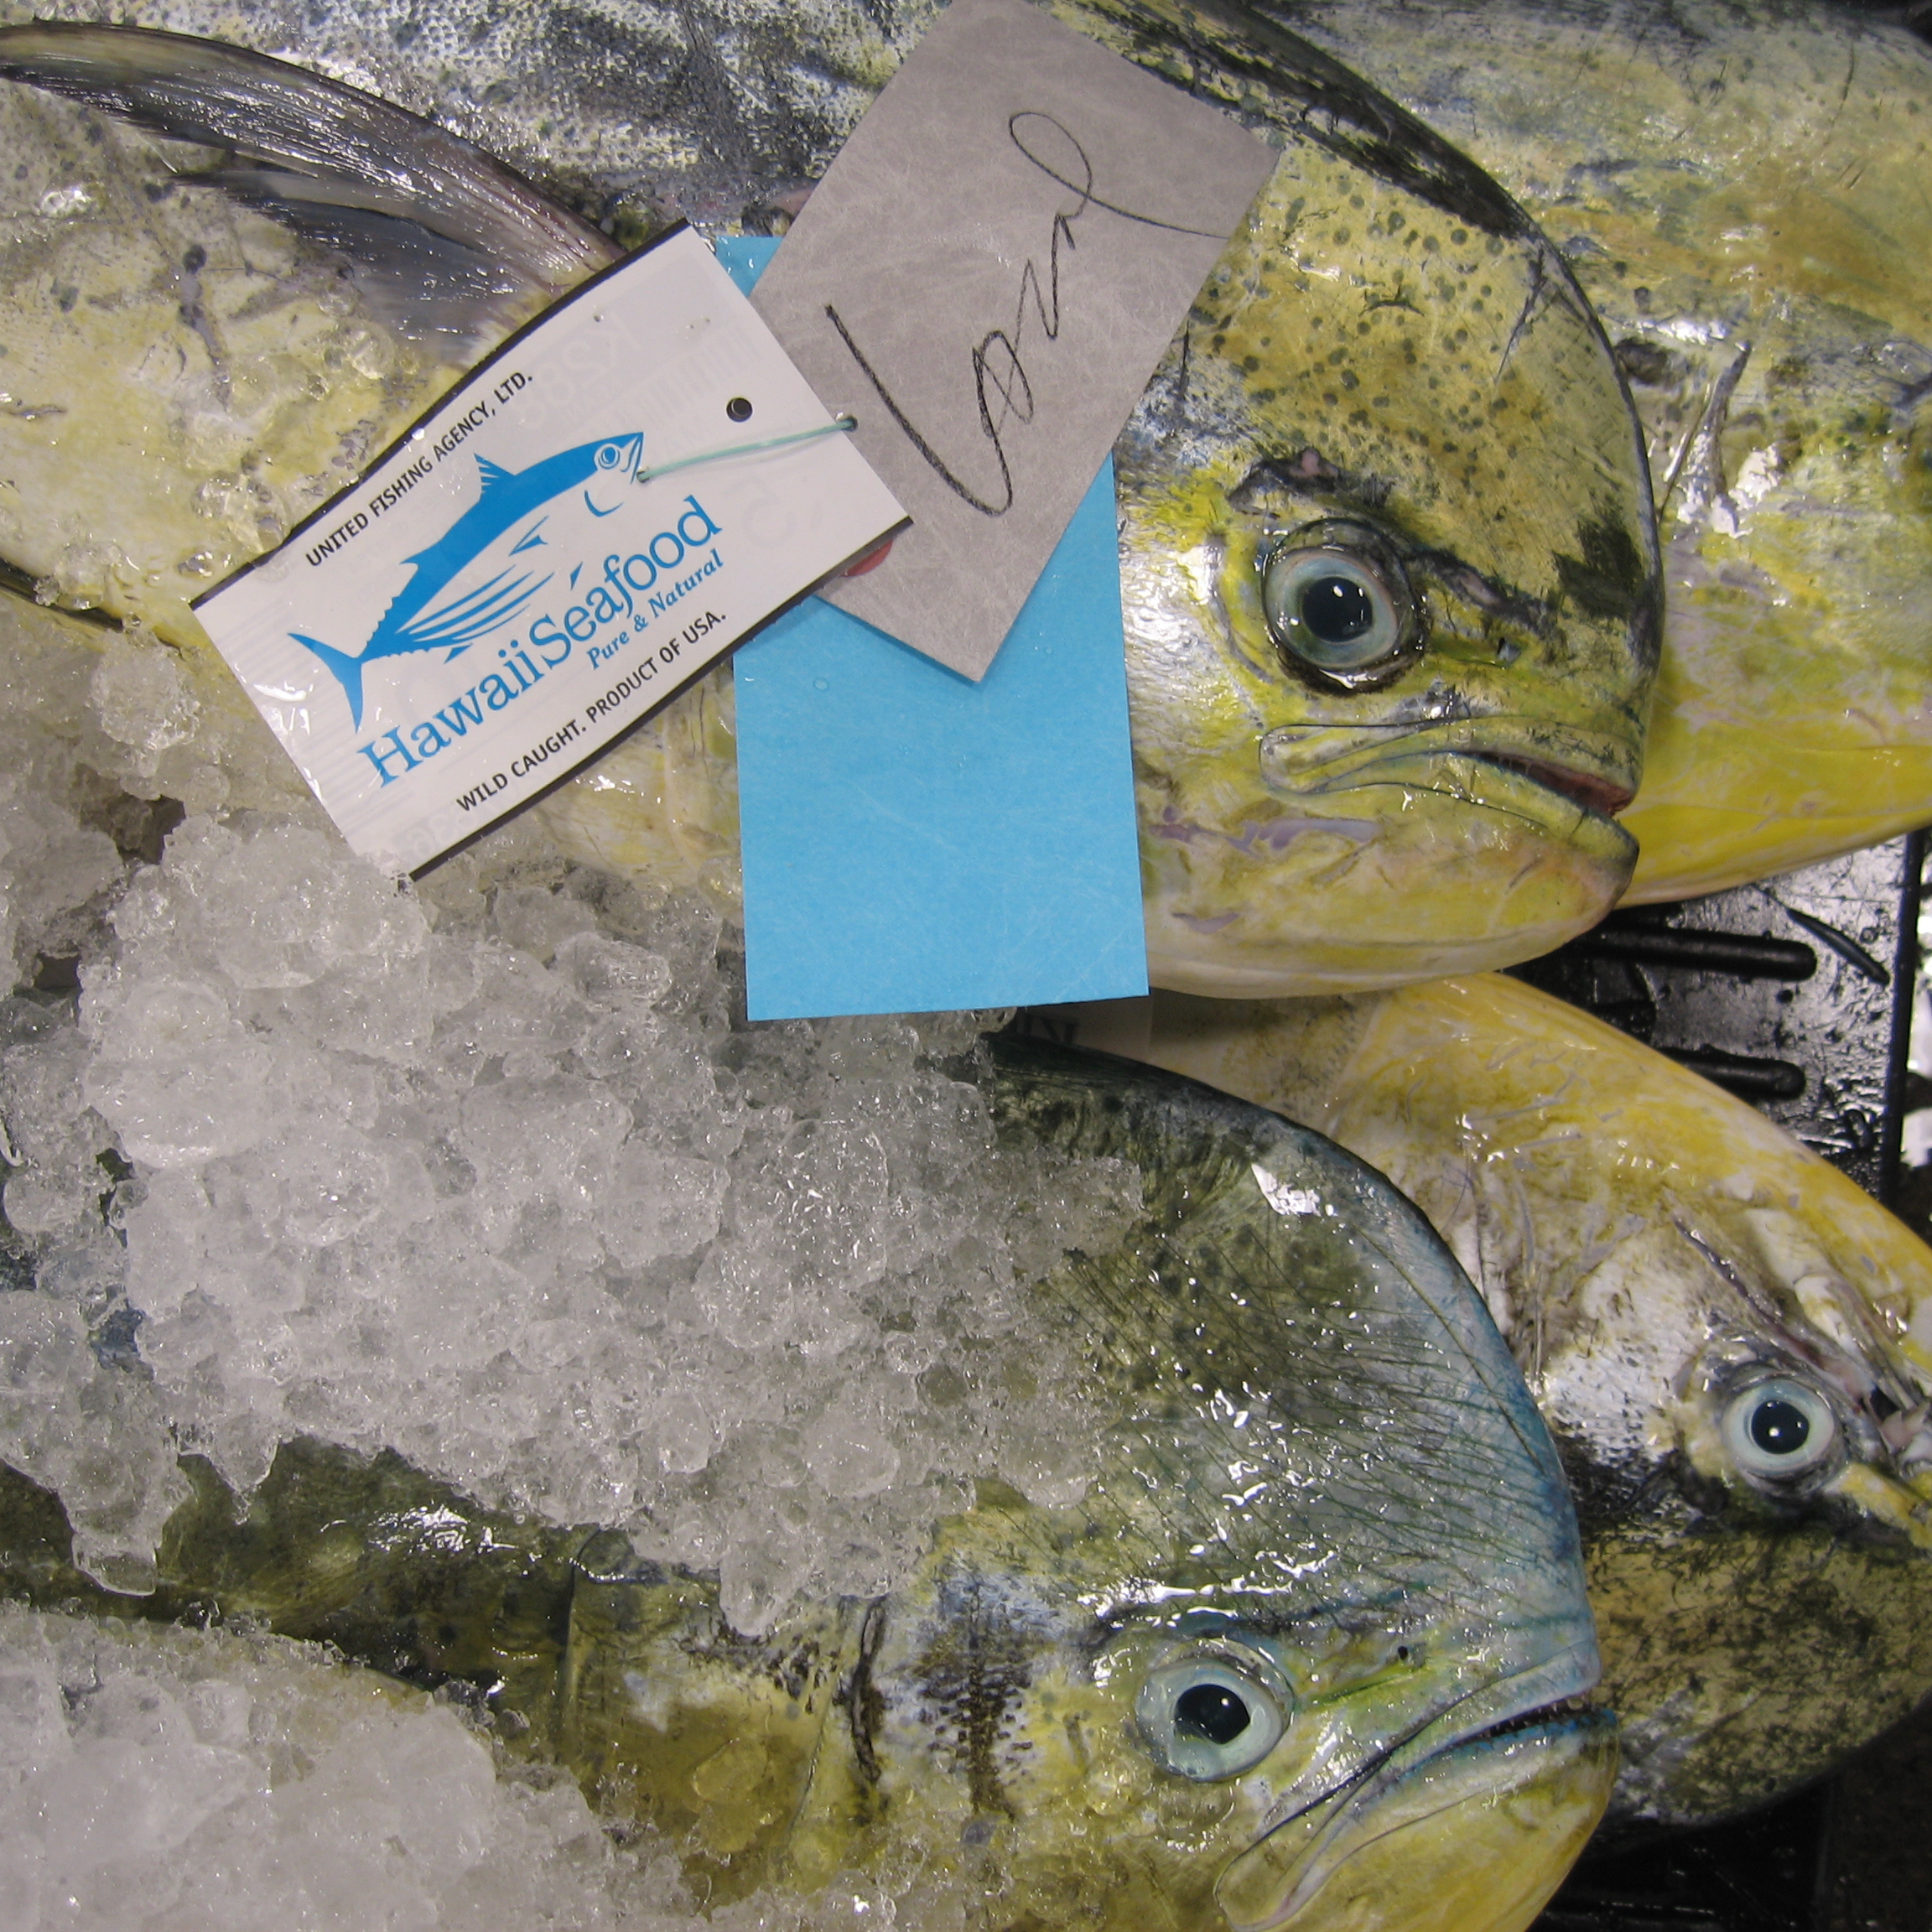
What is a fishery?
Defining by Location
Examples:
Pacific Ocean
North Pacific
Central North Pacific
Hawaii
Main Hawaiian Islands
Waikiki-Diamondhead Shoreline Fishing Management Area
Photo: John Kaneko

Slide 12
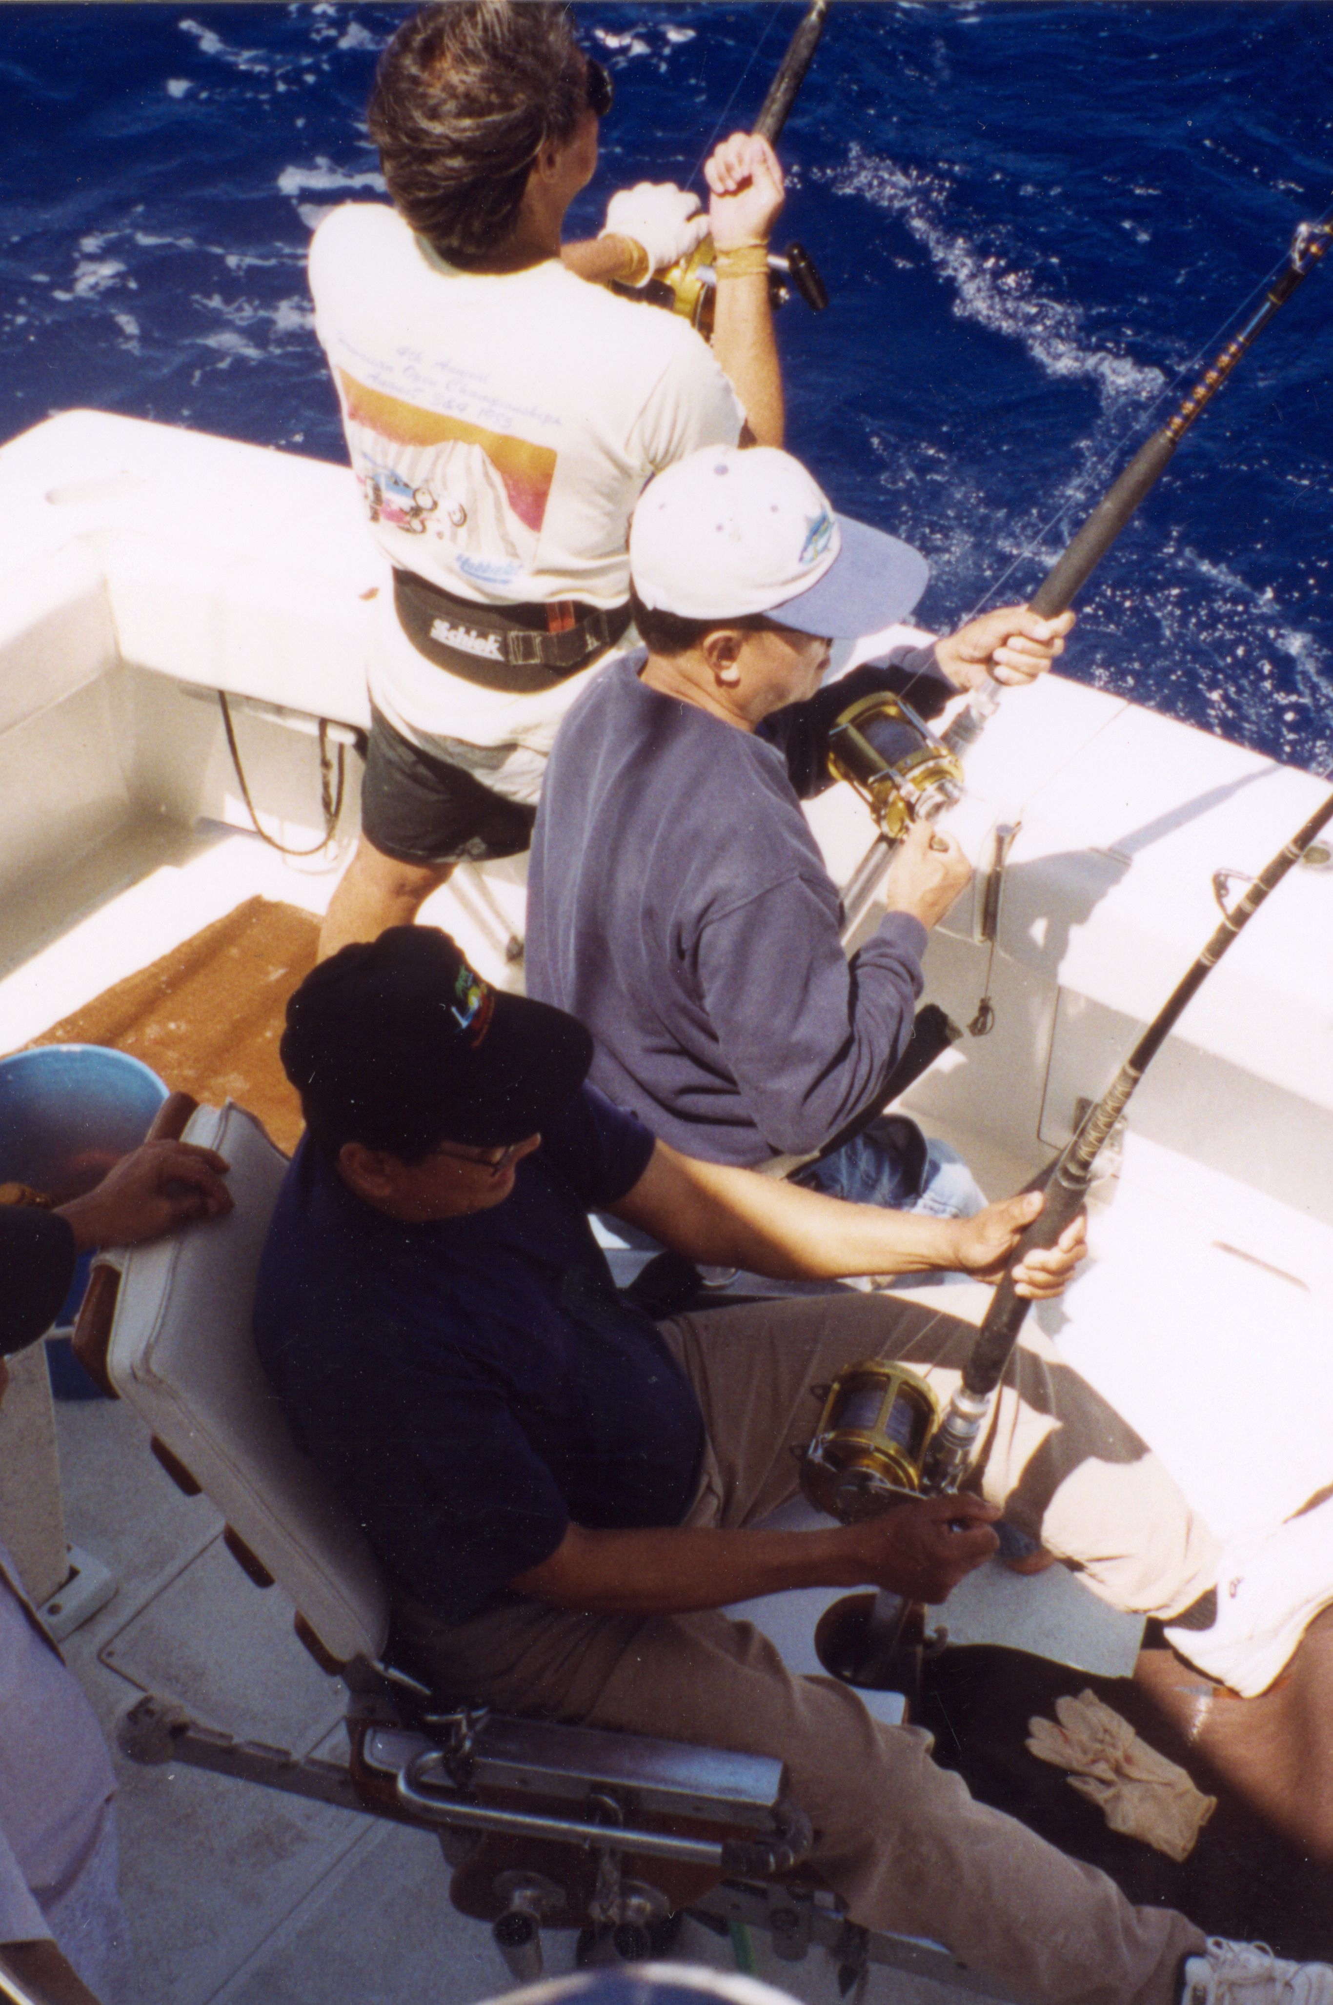
Defining by Purpose
In basic terms, the purpose of a fishery is either for subsistence (food), recreation (sport) or livelihood (commerce).
Photo: John Kaneko

Slide 13
What is a fishery?
Defining by Purpose
Subsistence: for food, sharing or barter, but not money
Recreational: for pleasure, sport, competition, food and/or catch and release
Commercial: catching and marketing fish for money
Artisanal: small-scale and traditional fishing for money and/or subsistence
Industrial: catching for money for uses other than human food
Aquarium: catching ornamental fish for money
Each of these types of fisheries can and should be managed.

Slide 14
What is a fishery?
Managing Fisheries with Different Purposes
It is common for several types
of fisheries on the same fishery resource to be managed simultaneously.
This requires a fishery management process that considers the impacts of the various fisheries on the fishery resource, habitat and ecosytem.
For example:
Aquarium fish fisheries
for live ornamental marine tropical fish and invertebrates
are important in some coral
reef areas where subsistence, recreational and commercial fisheries coexist.

Slide 15
What is a fishery?
Managing Fisheries with Different Purposes
It also requires an established decision-making process and defined management goals that take into consideration the diverse needs of stakeholders.
For example:
Industrial fisheries may catch forage fish species for the production of extracted fish oils (DHA & EPA) and fish meal for animal feeds, pet food, and other useful products. These species play a role as the base of the food web for other fish species caught for food and recreation.

Slide 16
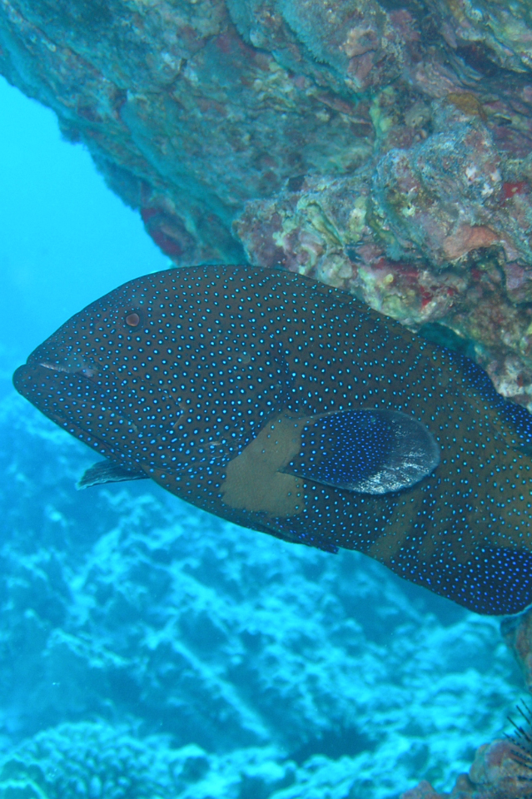
Defining by Environment
The environment, or habitat, where a fishery operates is important. It dictates which types of gear can be used. Each environment/habitat has different vulnerability to the impacts of fishing.
Photo: William J Walsh

Slide 17
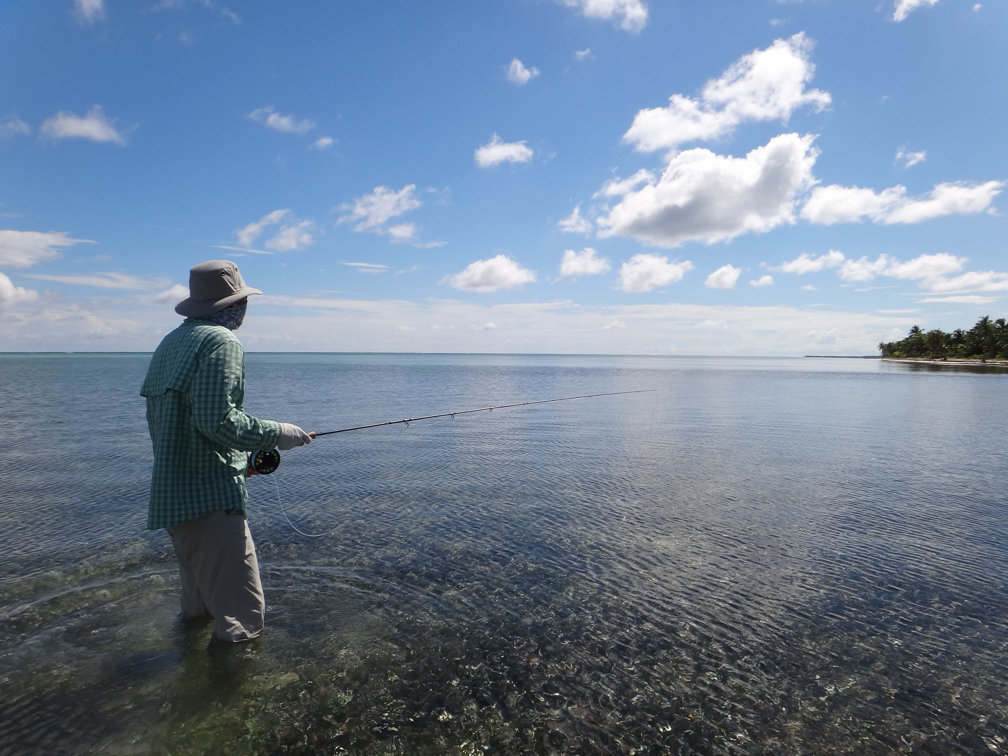
What is a fishery?
Defining by Environment
Examples:
Coral reef
Nearshore/Coastal
Demersal:
bottom habitat associated
Pelagic: open ocean, not associated with bottom habitat
Photo: John Kaneko

Slide 18
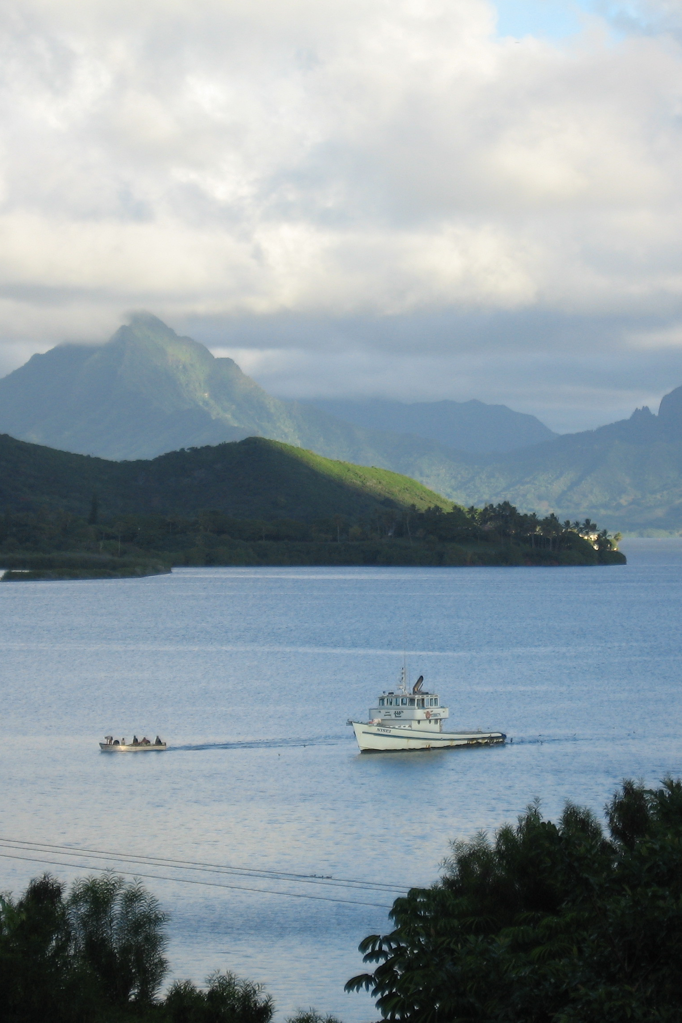
DefininG by
Fishing Method
The fishing method has impacts on catch rates, selectivity and habitat.
Photo: John Kaneko

Slide 19
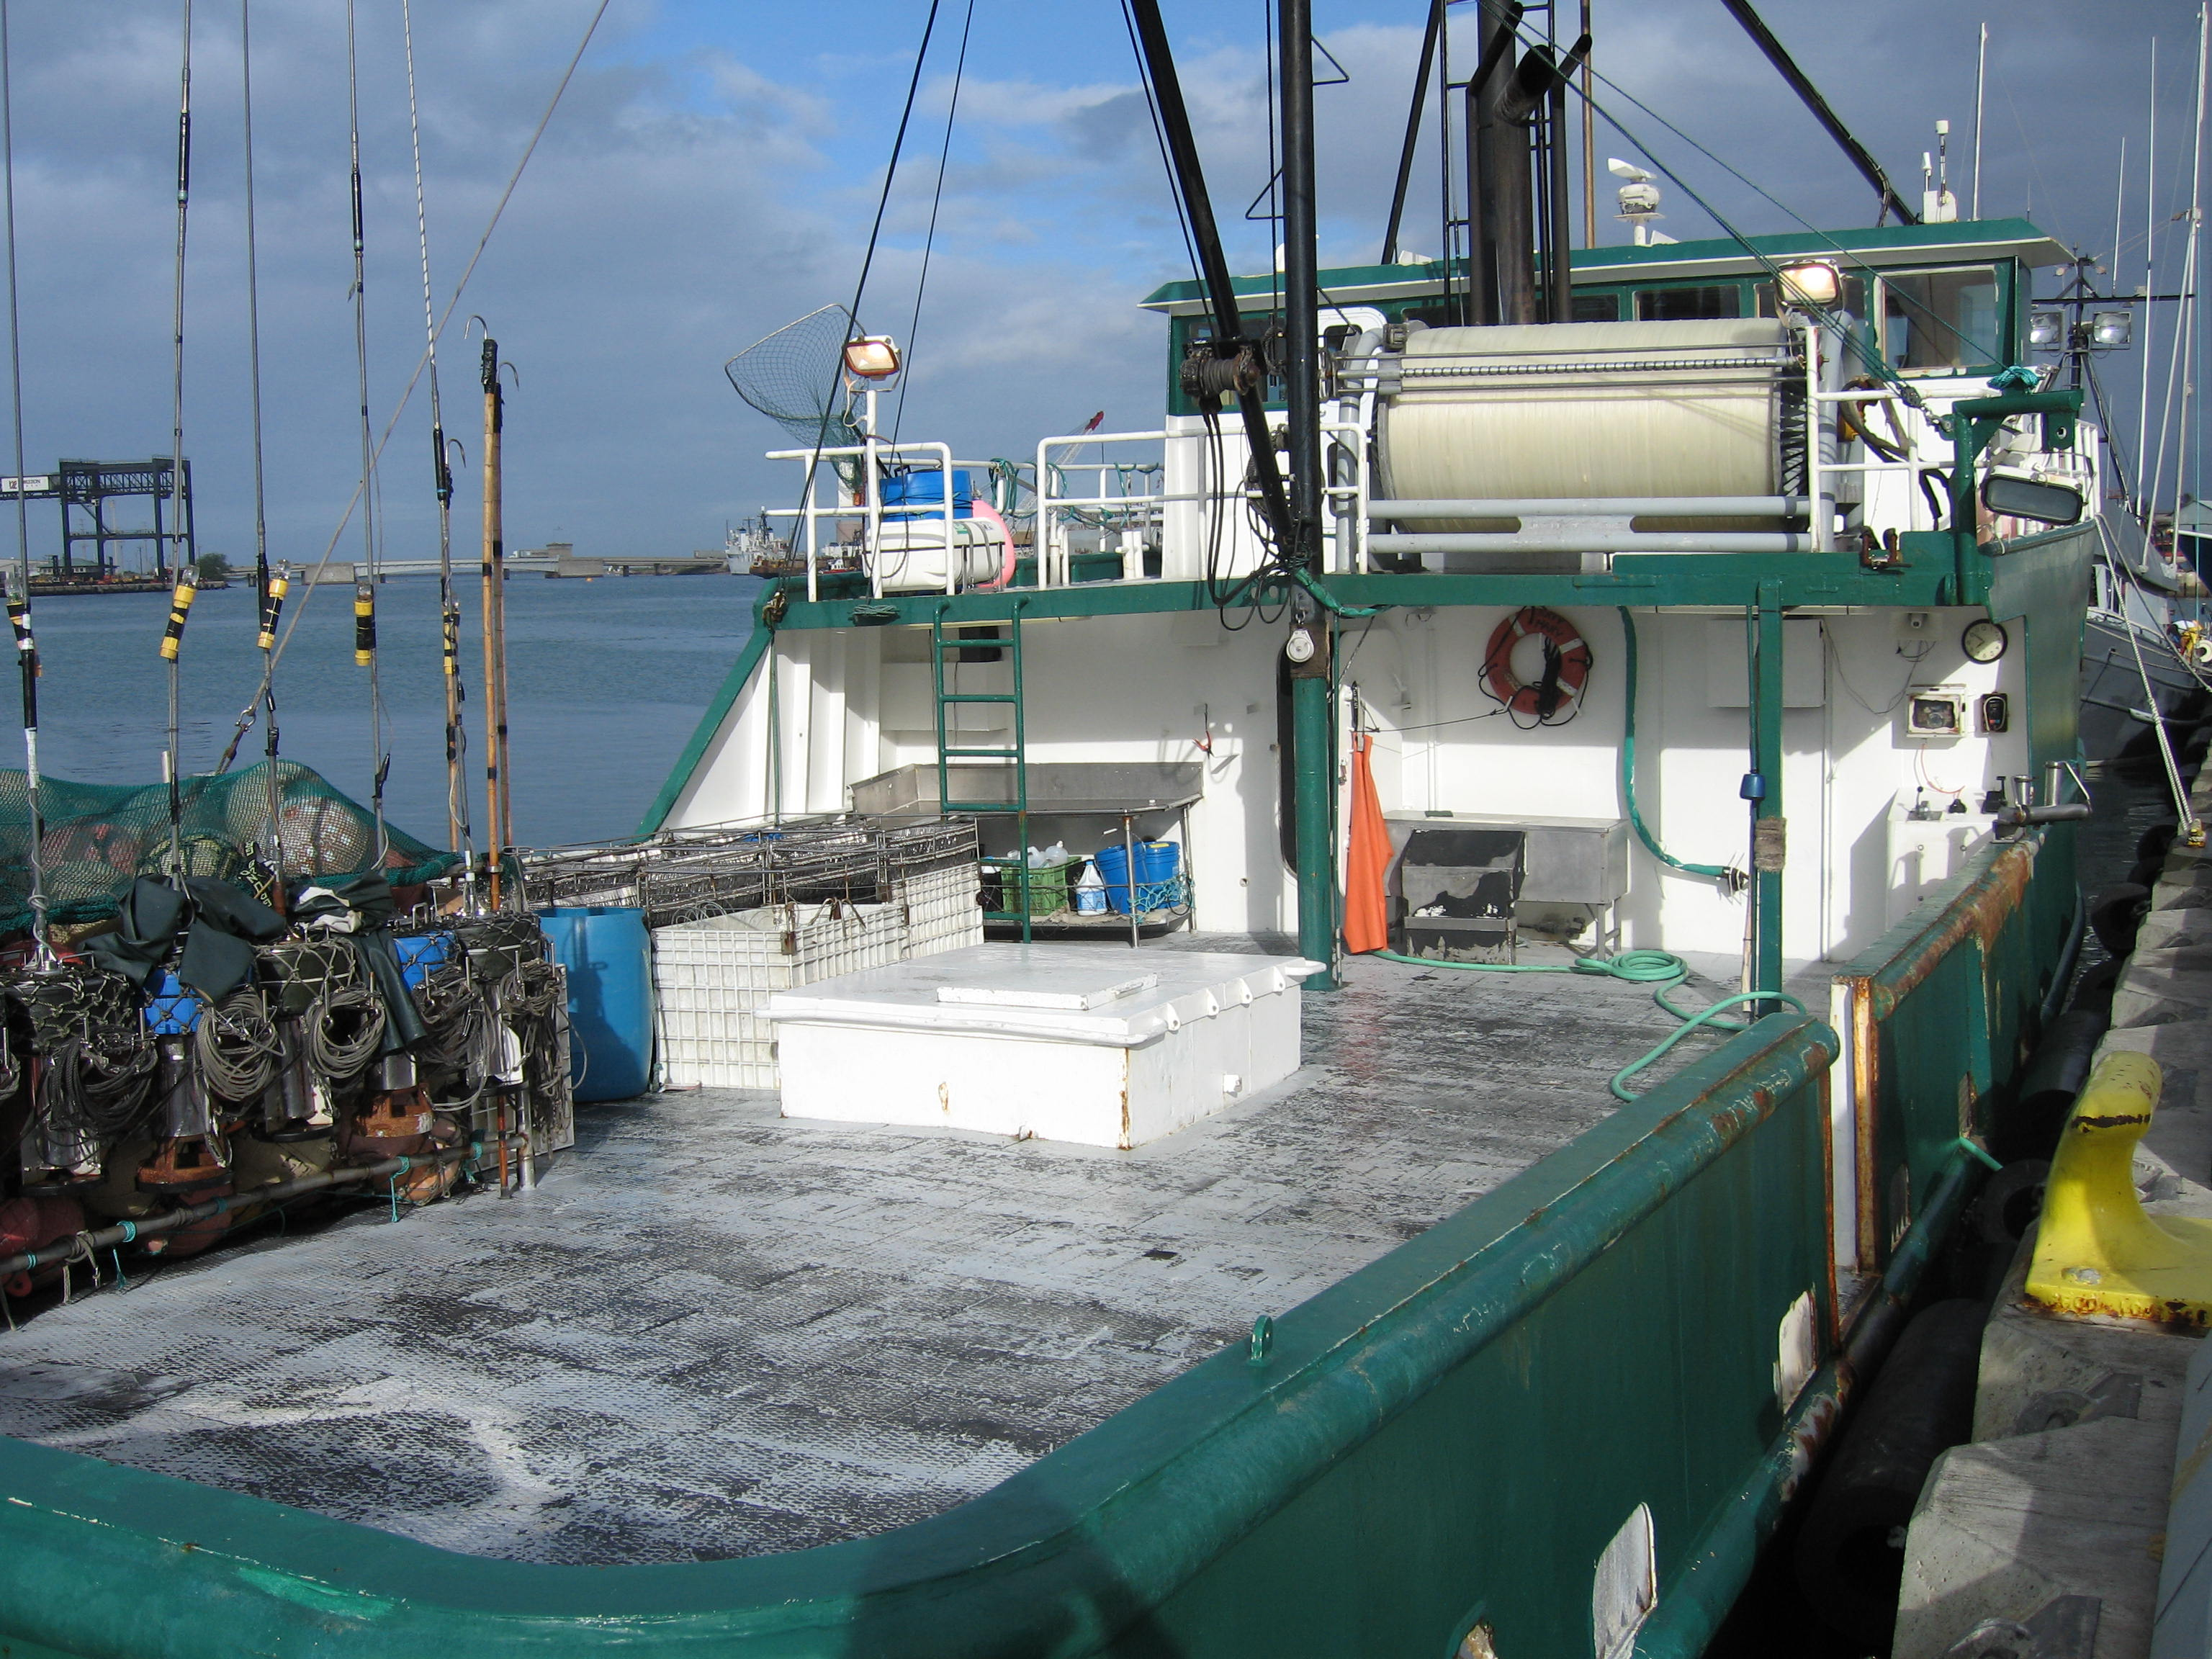
What is a fishery?
Defining by Fishing Method
spear
harpoon
gill net
purse seine
trawl
rod & reel
pole & line (live bait boat)
handline
troll
longline
Photo: John Kaneko

Slide 20
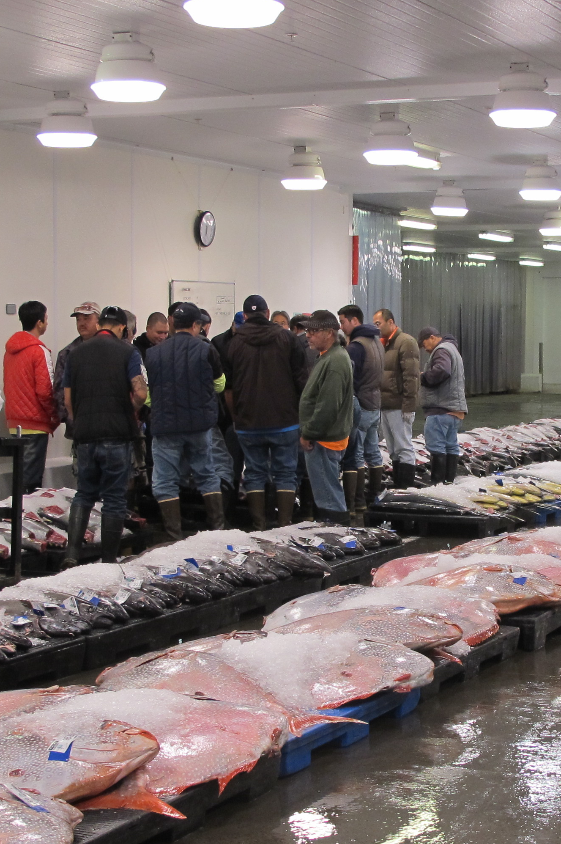
Defining by
Target Species
Marine fisheries are generally multi-species fisheries.
Photo: John Kaneko

Slide 21
What is a fishery?
Defining by Target Species
Catch:
Fisheries include the catch of finfish and invertebrates (shellfish).
Most fisheries may have a primary target species, but
also catch secondary marketable/edible species
cod
anchovy
menhaden
shrimp
crab
American lobster
scallop
bigeye tuna
swordfish

Slide 22
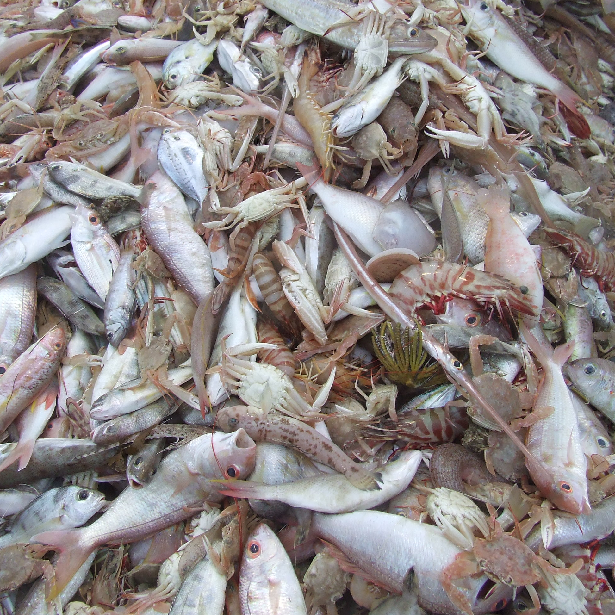
What is a fishery?
Defining by Target Species
Discards:
They may also catch and discard unwanted, undervalued and unmarketable species (economic discards).
As well as species that may not be retained by regulation (regulatory discards).
Photo: S. McGowan/AMC 2008/Marine Photobank

Slide 23
Defining by Management Jurisdiction
Some fisheries straddle areas of different management jurisdictions.

Slide 24
What is a fishery?
Defining by Management Jurisdiction
Well-managed and responsible fisheries operate in compliance with fishery regulations wherever they occur.
High seas areas (international waters) should not be unregulated and unmanaged fishing areas.
Examples:
Community-based management
State-managed
Federally-managed
International or Regional management

Slide 25
What is a fishery?
Examples of American Fisheries Include:
Maine’s commercial trap fishery for American lobster (Maine lobster fishery)
Alaska’s subsistence dip net fishery for Pacific salmon
Florida’s commercial trap fishery for stone crab
Eastern States’ commercial, industrial purse seine fishery for menhaden
Louisiana’s commercial, trawl fishery for Gulf shrimp
Kona’s tag & release recreational blue marlin
troll fishery

Slide 26
What is a fishery?
Examples of Hawaii Fisheries Include:
Hawaii’s commercial pelagic deep-set longline fishery for bigeye tuna
Hawaii’s commercial live bait boat fishery for skipjack (aku)
Hawaii’s subsistence nearshore-pelagic net fishery for mackerel scad (opelu)
Hawaii’s recreational spear fishery for reef fish
Hawaii’s recreational catch
& release, fly fishing, bonefish (oio) fishery
Hawaii’s commercial
trap fishery for deepwater shrimp
Notes:
OK

Slide 27
What is a fishery?
Examples of Fisheries that Do Not Exist in Hawaii:
Harpoon fishing for swordfish (ineffective)
Pole & Line fishing (bait boat) for bigeye tuna (ineffective)
Trawling for mid-water and bottomfish species (ineffective)
Fishing using drifting FADs (fish aggregating devices) (uneconomical)
Purse seining for tuna (prohibited)
Drift gill net fishing for pelagic species (prohibited)
Dynamite fishing for reef fish (prohibited)

Slide 28
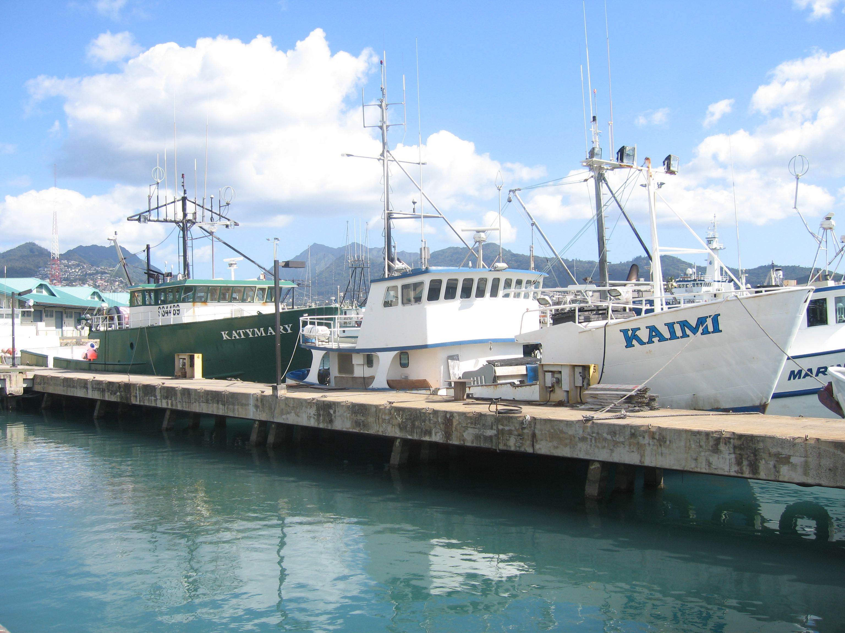



What is a Fishery?
Written by John Kaneko MS, DVM, Hawaii Seafood Council, Honolulu, Hawaii
July 2015
With support from the
Harold K.L Castle Foundation
Photo: John Kaneko

