Slide 1
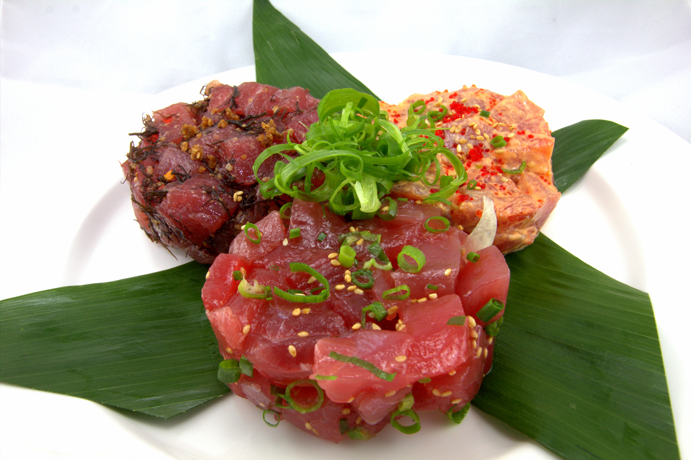
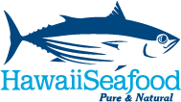
Which commercial fisheries produce local seafood in Hawaii?
John Kaneko MS, DVM
Hawaii Seafood Council
Photo: Toni Wong

Slide 2
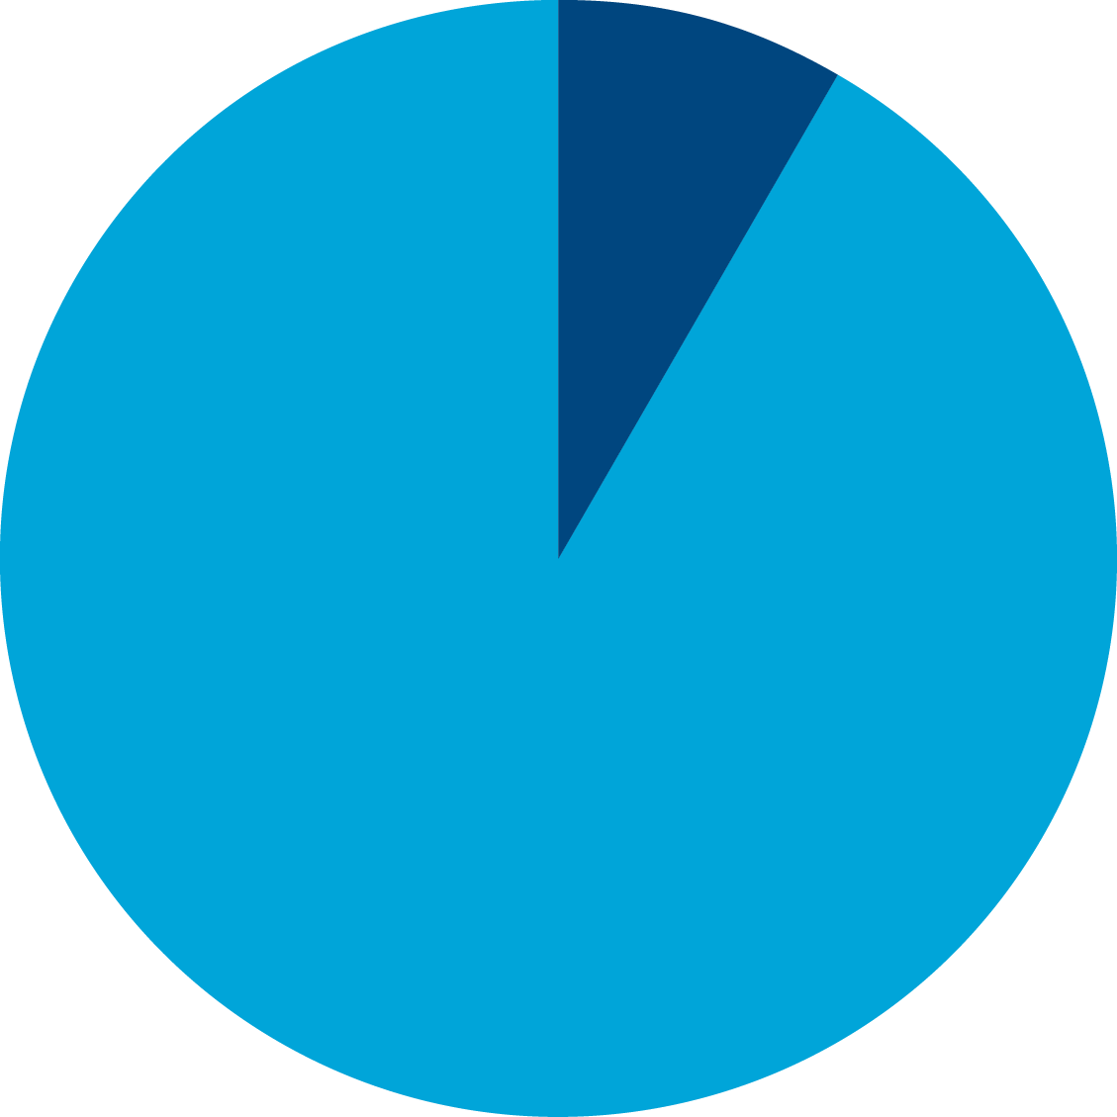
LOCAL SEAFOOD IN HAWAII
US Commercial Seafood Supply in 2013
US Commercial Seafood Supply in 2013 (edible fishery products round weight basis) | Billions lbs | Percentage of US Supply
US Domestic Landings Remaining in US Market US Domestic Commercial Landings (8.053) minus Exports (7.066) | 0.99 | 9%
US Imports | 10.53 | 91%
Total Seafood Supply (Minus Exports) | 11.52 | 100%
91%
imports
Source: NOAA, 2014. Fisheries of the United States 2013.

Slide 3
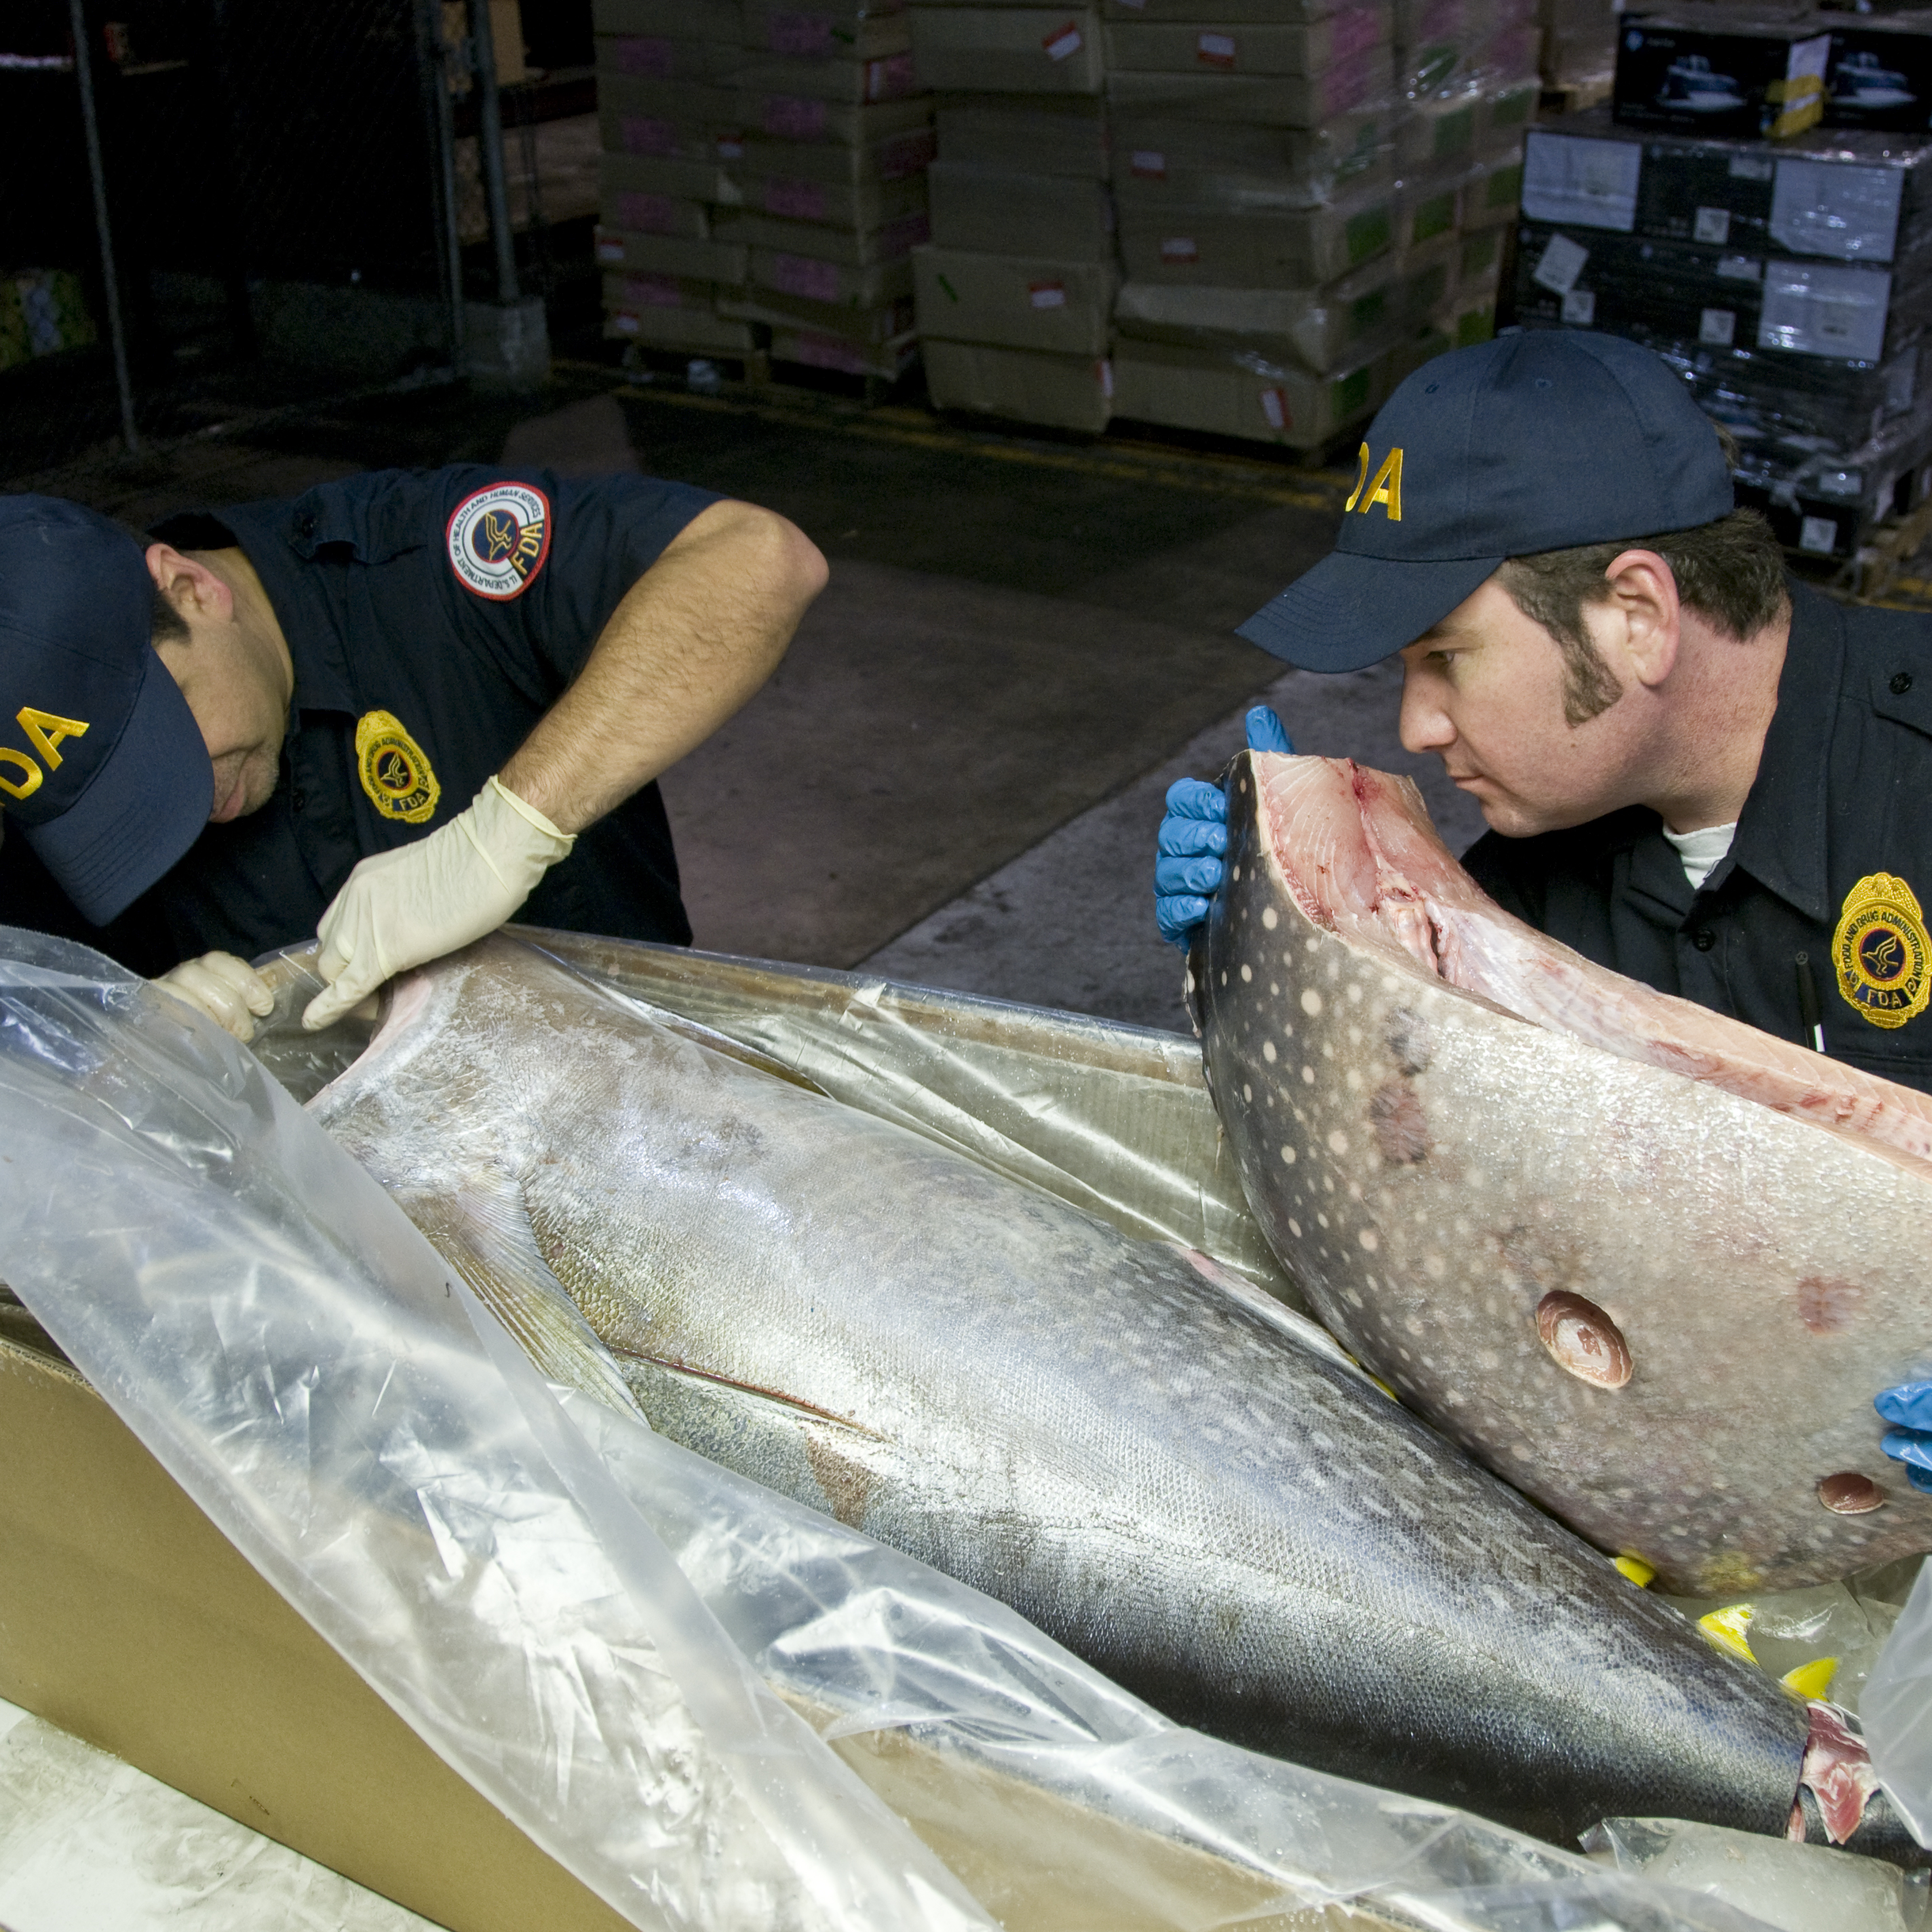
LOCAL SEAFOOD IN HAWAII
91% of US Commercial Seafood is Imported
The US seafood market is dominated by imported seafood.
The management of foreign fisheries and aquaculture needs
to be scrutinized for sustainability and food safety.
Source: NOAA, 2014. Fisheries of the United States 2013,
Photo: Michael J. Ermarth/FDA

Slide 4
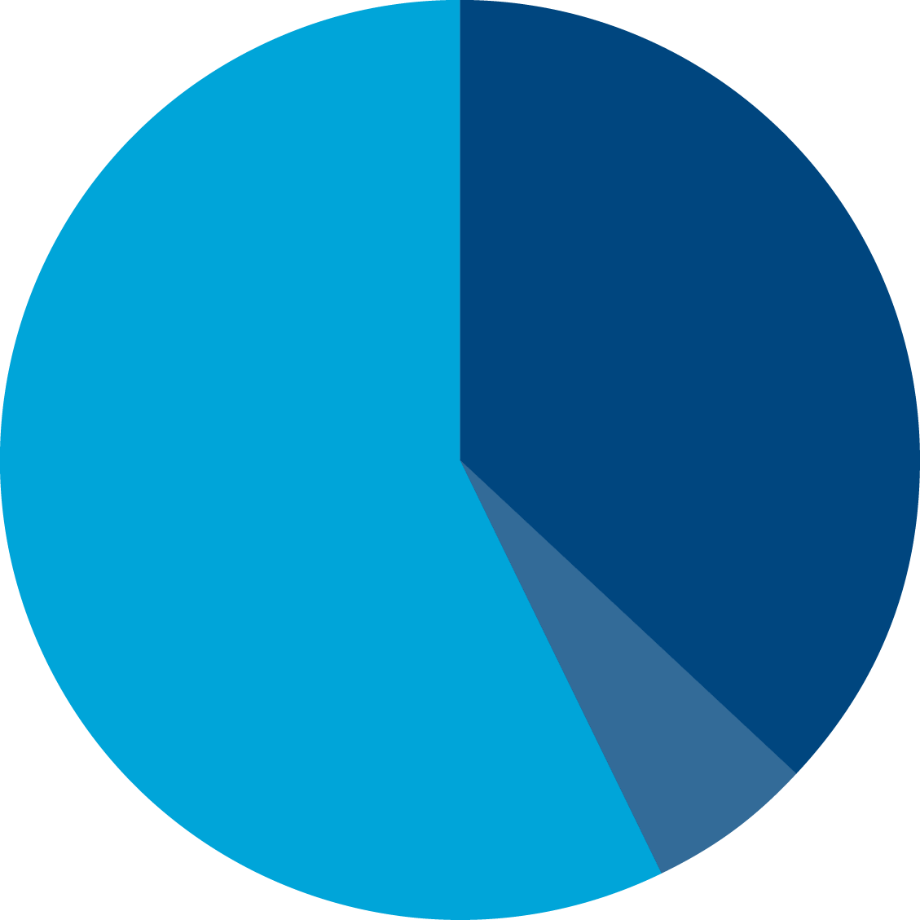
LOCAL SEAFOOD IN HAWAII
Hawaii Commercial Seafood Supply in 2009
Hawaii Commercial Seafood Supply in 2009 | Million lbs | Percentage of Hawaii Supply
Local Hawaii Landings | 14.38 | 37%
US Domestic Landings | 2.47 | 6%
US Imports | 22.08 | 57%
Total Hawaii Seafood Supply | 38.92 | 100%
HI 57%
foreign imports
Source: NOAA, 2010. Fisheries of the United States 2009; Loke, M., C. Geslani, B. Takenaka and P Leung. 2012. Seafood Consumption and Supply Sources in Hawaii 2000-2009. Mar Fish Rev 74(4):44-51. Weights may not add up due to rounding.

Slide 5
LOCAL SEAFOOD IN HAWAII
57% of Hawaii’s Commercial Seafood Supply is Imported
Hawaii’s seafood supply is much less dominated by
foreign imports than the rest of the nation.
(In 2009, Hawaii imported 57%)
Hawaii’s self-sufficiency in seafood far exceeds
the rest of the nation.
US 91%
foreign imports
HI 57%
foreign imports
Source: Loke, M., C. Geslani, B. Takenaka and P Leung. 2012.
Seafood Consumption and Supply Sources in Hawaii 2000-2009. Mar Fish Rev 74(4):44-51.

Slide 6
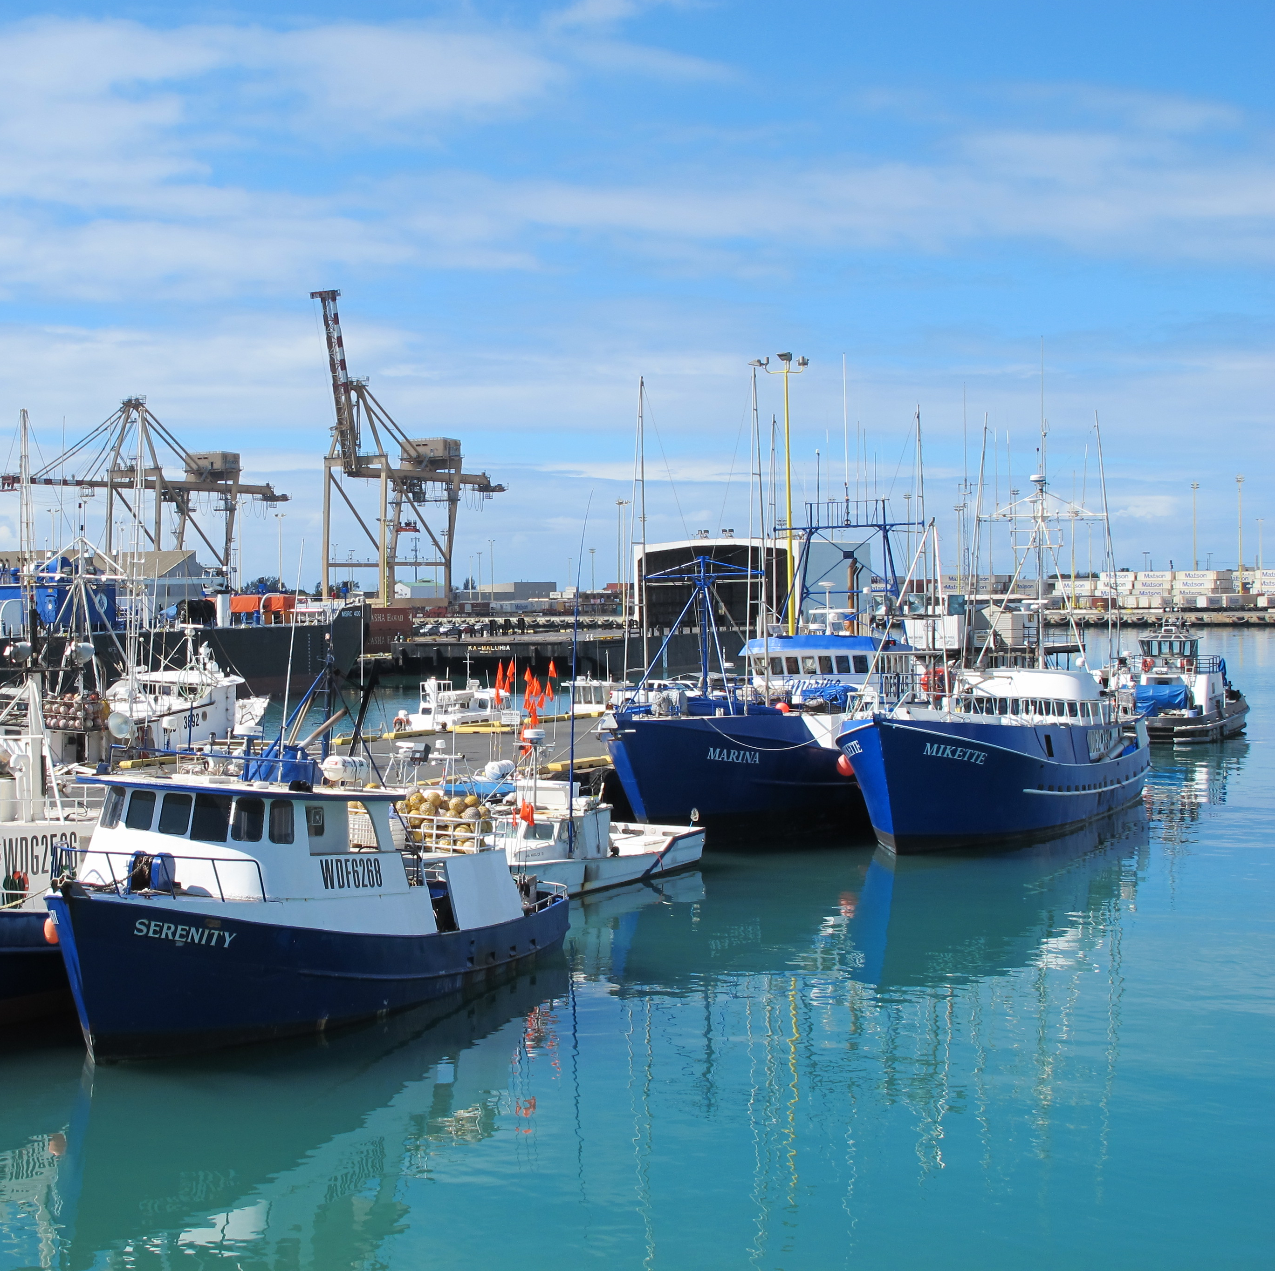
LOCAL SEAFOOD IN HAWAII
2013 National Ranking of Honolulu as a Fishing Port
Hawaii’s major fishery is a
low volume, high value fishery.
“We do more with less.”
Volume of Landings | 29 million lbs
Port Rank by Volume | 32nd in US
Value of Landings | $100 million
Port Rank by Value | 6th in US
Source: NOAA, 2014. Fisheries of the United States 2013.
Photo: John Kaneko

Slide 7
LOCAL SEAFOOD IN HAWAII
What type of local wild fish do we catch and eat?
Rank | Commercially-Caught Hawaii Wild Fish Species 2012 | Landed Volume (million lbs) | Percentage
1 | Hawaii Pelagic Fish Species. (tunas, billfish and associated species) | 32.10 | 97%
2 | Hawaii Small Coastal Pelagic Species (bigeye scad - akule, and mackerel scad - opelu) | 0.39 | 1%
3 | Hawaii Reef Fish Species | 0.35 | 1%
4 | Hawaii Bottomfish Species (opakapaka, onaga, hapuupuu, ehu, lehi, gindai, kalekale, uku) | 0.30 | 1%
 | TOTAL | 33.14 | 100%
Source: NOAA. http://www.pifsc.noaa.gov/wpacfin/hi/Data/Landings_Charts/hr3a.htm.

Slide 8
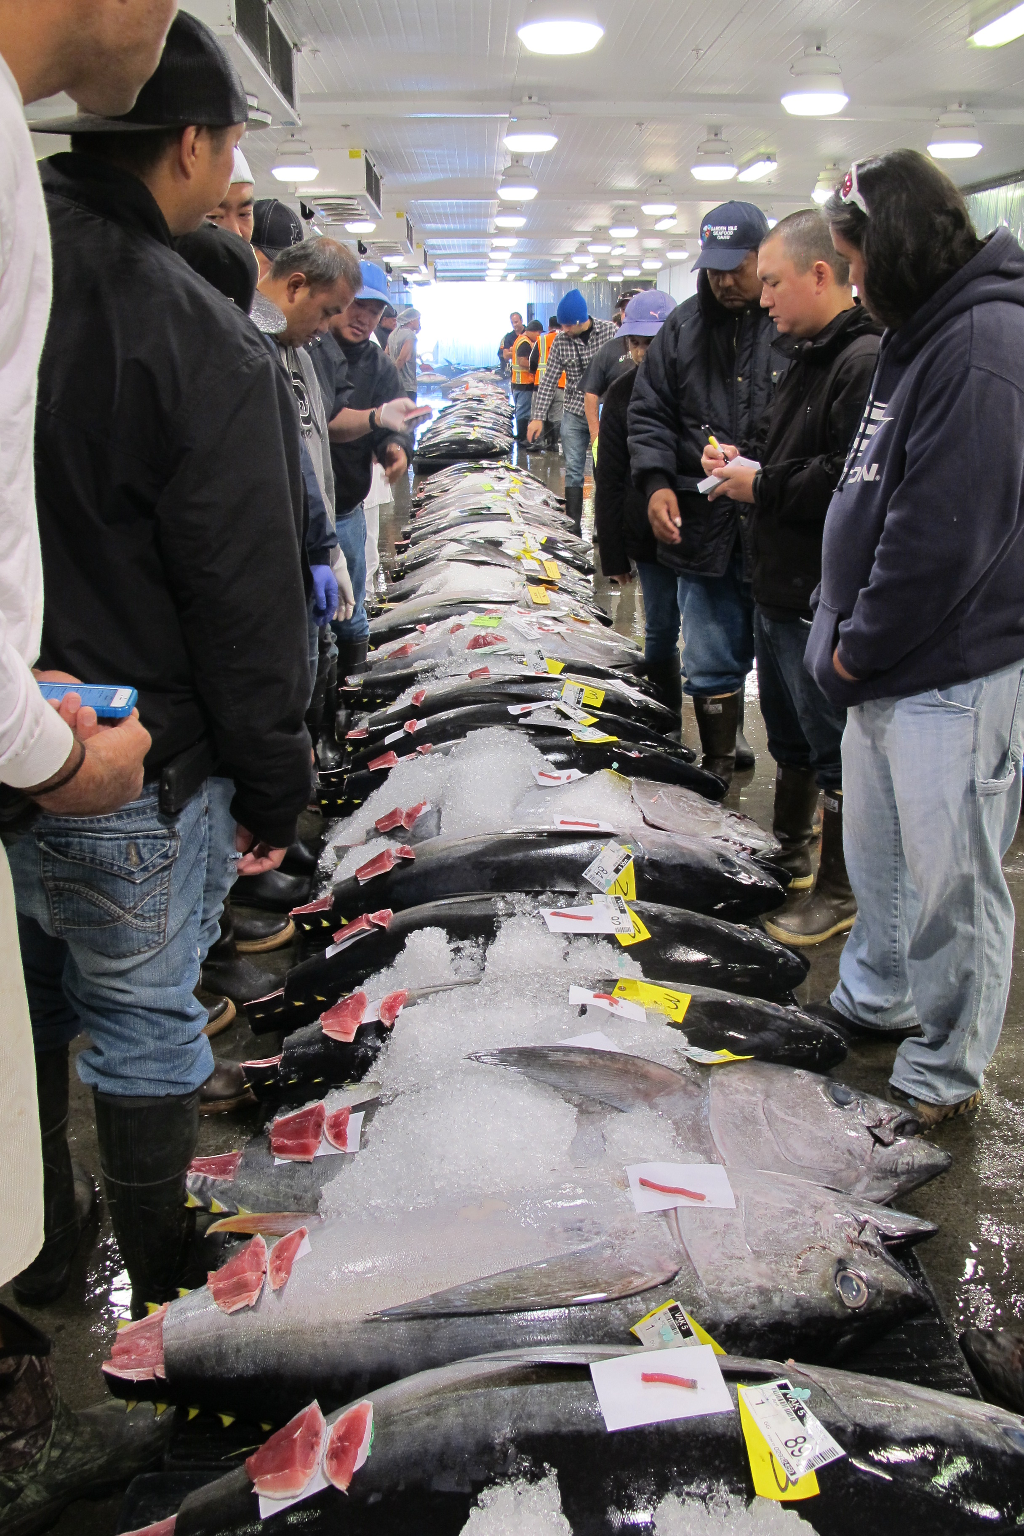
LOCAL SEAFOOD IN HAWAII
What type of local wild fish do we catch and eat?
As an island state, it makes sense that the majority of the commercial locally-caught fish
we eat are from the open ocean (pelagic).
Open ocean (pelagic) fish dominate the locally-caught supply of fish in the Hawaii market.
Source: NOAA. http://www.pifsc.noaa.gov/wpacfin/hi/Data/Landings_Charts/hr3a.htm
Photo: John Kaneko

Slide 9
Hawaii Commercial Fishery Landings (by Value In 2012)
Fishery | Landed Value (million $) | Percentage
Hawaii Deep-set Multi-species Pelagic Longline Fishery for bigeye tuna (and other pelagic species) | 86.52 | 78%
Main Hawaiian Islands Pelagic Troll Fishery | 8.59 | 8%
Hawaii Shallow-set Multi-species Pelagic Longline Fishery for swordfish (and other pelagic species) | 5.81 | 5%
Main Hawaiian Islands Pelagic Handline Fishery | 3.36 | 3%
Hawaii Offshore Pelagic Handline Fishery | 1.09 | <1%
Subtotal Pelagic Fish only | 106.36 | 96%
Hawaii Small Coastal Pelagic Species Fishery (bigeye scad and mackerel scad) | 1.21 | 1%
Hawaii Reef Fish Species | 1.28 | 1%
Hawaii Bottomfish Handline Fishery | 1.66 | 2%
TOTAL | 110.52 | 100%
Sources: NOAA. http://www.pifsc.noaa.gov/wpacfin/hi/dar/Pages/hi_data_1.php
For bottomfish and small coastal pelagics data: http://www.pifsc.noaa.gov/wpacfin/reportlanding.php
For reef fish data: http://www.pifsc.noaa.gov/wpacfin/hi/dar/Pages/hi_data_3.php
Values may not add up due to rounding and other small fisheries’ landings.

Slide 10
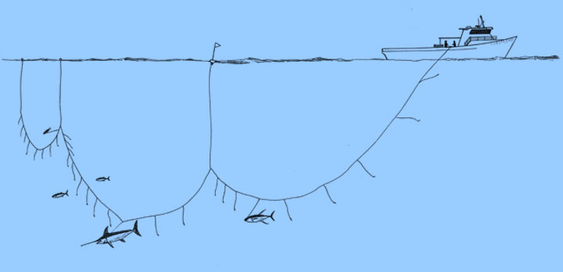
LOCAL SEAFOOD IN HAWAII
What types of fish do these fisheries produce?
Hawaii’s Pelagic Fish
caught on LONGLINE gear include:
tuna (bigeye, yellowfin, albacore and skipjack tuna)
billfish (swordfish, blue marlin, striped marlin, spearfish)
associated pelagic species (mahimahi, wahoo, opah, sickle pomfret, escolar, mako and thresher shark)
Source: NOAA. http://www.pifsc.noaa.gov/wpacfin/hi/Data/Landings_Charts/hr3a.htm
Illustration: Les Hata

Slide 11
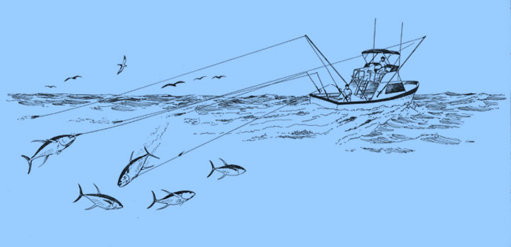
LOCAL SEAFOOD IN HAWAII
What types of fish do these fisheries produce?
Hawaii’s Pelagic TROLL fishery catches:
yellowfin tuna
skipjack
mahimahi
wahoo
blue marlin
striped marlin
spearfish
Source: NOAA. http://www.pifsc.noaa.gov/wpacfin/hi/Data/Landings_Charts/hr3a.htm
Illustration: Les Hata

Slide 12
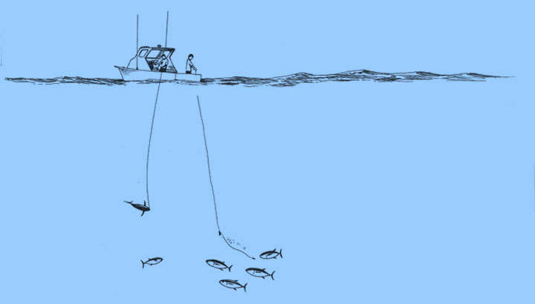
LOCAL SEAFOOD IN HAWAII
What types of fish do these fisheries produce?
Hawaii’s Pelagic OFFSHORE HANDLINE fishery tends to target:
Small bigeye tuna that aggregate at offshore seamounts
Associated pelagic fish
Source: NOAA. http://www.pifsc.noaa.gov/wpacfin/hi/Data/Landings_Charts/hr3a.htm
Illustration: Les Hata

Slide 13
LOCAL SEAFOOD IN HAWAII
What types of fish do these fisheries produce?
Main Hawaiian Islands (MHI) Pelagic HANDLINE fishery tends to target:
yellowfin tuna (summer run)
albacore
swordfish (fishing at night)
Source: NOAA. http://www.pifsc.noaa.gov/wpacfin/hi/Data/Landings_Charts/hr3a.htm
Illustration: Les Hata

Slide 14
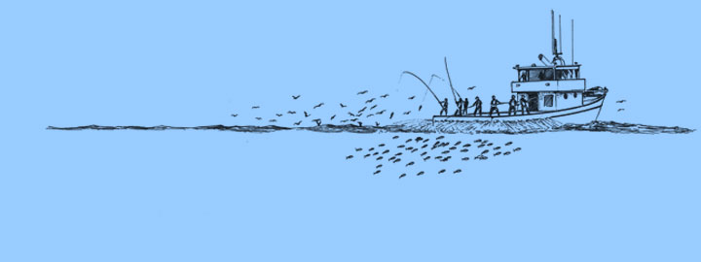
LOCAL SEAFOOD IN HAWAII
What types of fish do these fisheries produce? (cont’d)
Hawaii’s POLE & LINE (live baitboat aku) fishery catches:
skipjack (aku)
yellowfin (ahi)
Source: NOAA. http://www.pifsc.noaa.gov/wpacfin/hi/Data/Landings_Charts/hr3a.htm
Illustration: Les Hata

Slide 15
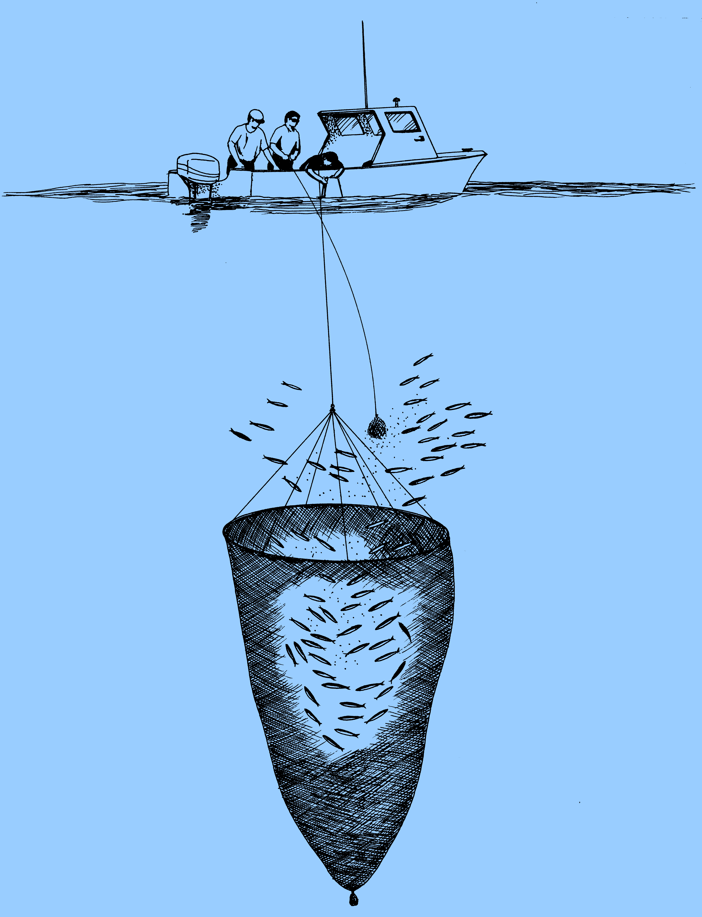
LOCAL SEAFOOD IN HAWAII
What types of fish do these fisheries produce? (cont’d)
Hawaii’s SMALL COASTAL PELAGIC
fish are caught by hook, hoop net and surround net including:
mackerel scad (opelu)
bigeye scad (akule)
Source: NOAA. http://www.pifsc.noaa.gov/wpacfin/hi/Data/Landings_Charts/hr3a.htm
Illustration: Les Hata

Slide 16
LOCAL SEAFOOD IN HAWAII
What types of fish do these fisheries produce? (cont’d)
Hawaii’s REEF FISH Species
include:
bigeyes/glasseyes
damselfishes
jacks
filefishes
rudderfishes
flounders
scorpionfishes
goatfishes
squirrelfishes
surgeonfishes
tangs
hawkfishes
flagtails
trumpetfishes
parrotfishes
wrasses
pufferfishes
Source: NOAA. http://www.pifsc.noaa.gov/wpacfin/hi/Data/Landings_Charts/hr3a.htm

Slide 17
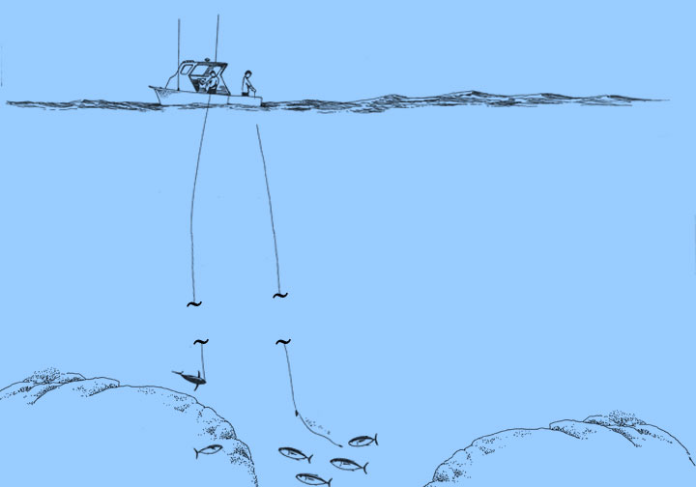
LOCAL SEAFOOD IN HAWAII
What types of fish do these fisheries produce? (cont’d)
The Handline Fishery catches the “Deep 7” BOTTOMFISH complex:
pink snapper (opakapaka)
long tail red snapper (onaga)
short tail red snapper (ehu)
maroon snapper (lehi)
Hawaiian seabass (hapuupuu)
flower snapper (gindai)
von Siebold’s snapper (kalekale)
blue-green snapper (uku) are also caught, but are not included in the “Deep 7”.
Source: NOAA. http://www.pifsc.noaa.gov/wpacfin/hi/Data/Landings_Charts/hr3a.htm
Illustration: Les Hata

Slide 18
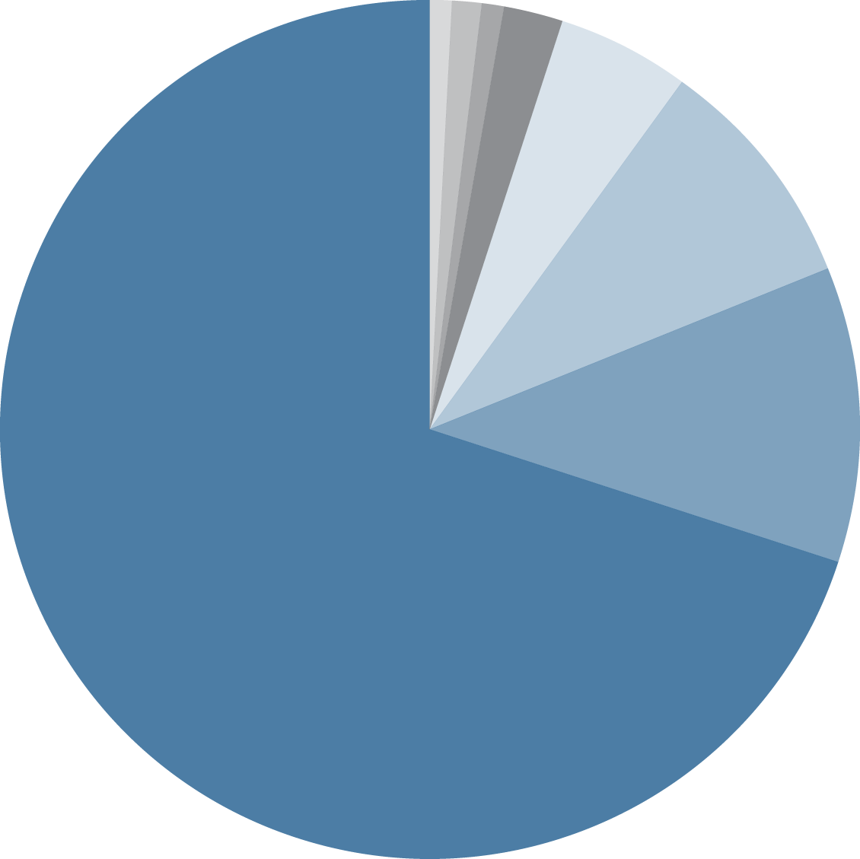
LOCAL SEAFOOD IN HAWAII
What are the relative proportions of local fish
produced by these fisheries? (by weight landed in 2012)
Pelagic Tuna Longline | 70%
Pelagic Troll | 11%
Pelagic Swordfish Longline | 9%
Pelagic Handline | 5%
Offshore Pelagic Handline | 2%
Coastal Pelagic | 1%
Reef Fish | 1%
Bottomfish Handline | <1%
5%
9%
11%
70%
Pelagic Tuna
Longline
Sources: NOAA. http://www.pifsc.noaa.gov/wpacfin/hi/dar/Pages/hi_data_1.php
For bottomfish and small coastal pelagics data: http://www.pifsc.noaa.gov/wpacfin/reportlanding.php
For reef fish data: http://www.pifsc.noaa.gov/wpacfin/hi/dar/Pages/hi_data_3.php
Percentages may not add up to 100% due to rounding and other small fisheries’ landings.

Slide 19
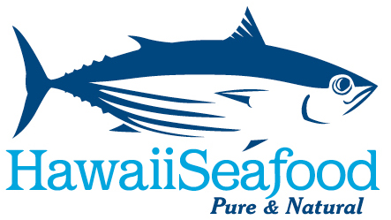


Which commercial fisheries produce local seafood in Hawaii?
Written by John Kaneko MS, DVM, Hawaii Seafood Council, Honolulu, Hawaii
July 2015
With support from the
Harold K.L Castle Foundation
Photo: Toni Wong

